Slide 1
February 2017
Natalia Aguirre
Alliance for Hope International
Notes:
Thank you for being here today to talk about such a critical public health epidemic at a truly important time in our country. Interpersonal violence affects our communities and its impact see no racial boundaries, economic differences or religious affiliation. It is something that not only impacts us in the now but for generations to come.

Slide 2
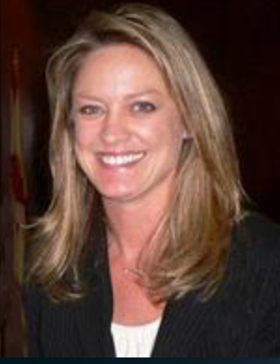
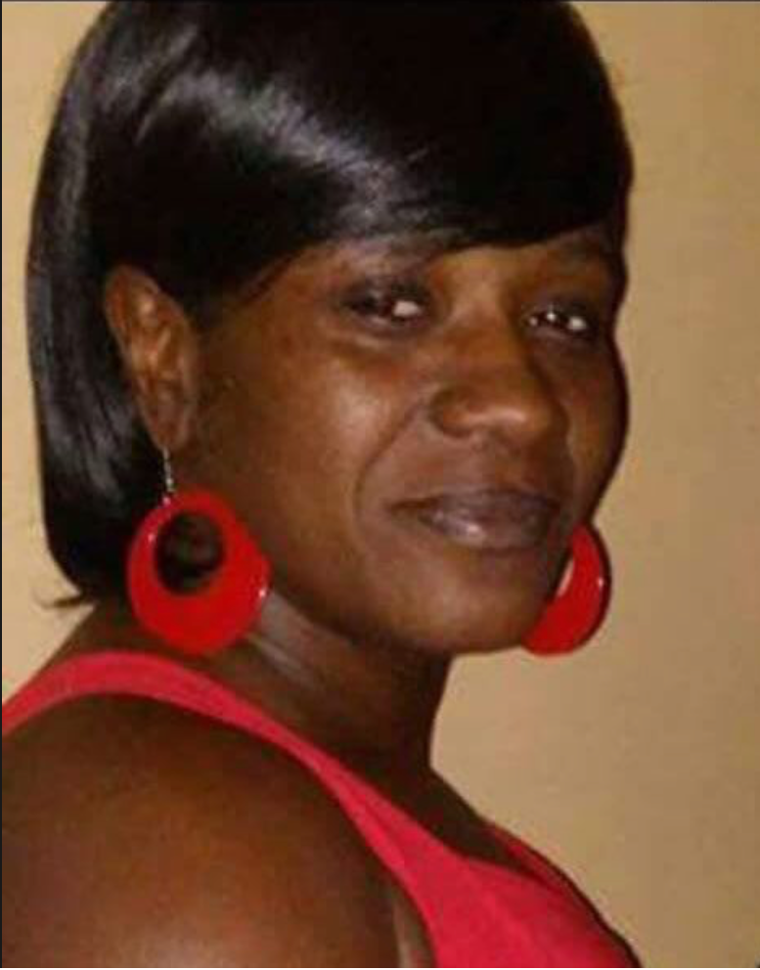
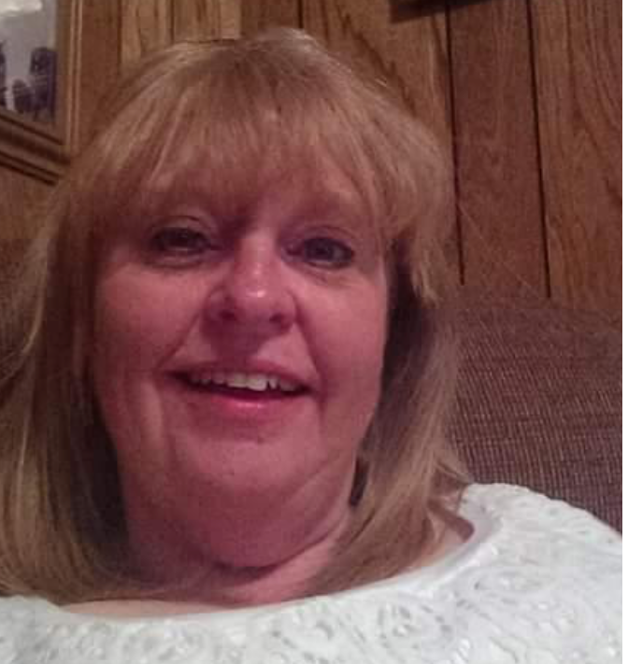
We honor those who have lost loved ones to domestic violence
From 2001 - 2012
American Troops killed in Afghanistan and Iraq: 6,488
American women murdered by current/former male partners: 11,766
3 women murdered a day by a current or former male partner
Notes:
As we always do at Alliance for hope – we begin every presentation honoring those who have lost their lives or loved ones to domestic violence.
From 2001 to 2012 READ FROM SLIDE
That means an average of 3 women are murdered EVERY Day by a current or former male partner. And these statistics do not reflect the number of men who loose their lives as well.
Alisa Kinsaul – Panama City, FL
Quadeedrah Clinton –Charleston, SC
Louann Anderton - West Valley City, UT

Slide 3
We recognize those that risk their lives to protect us…
20 out of 91 Police Officers killed responding to a domestic violence calls from 2010 – 2014
2 out of 5 mass shootings from 2009-2012 began with a gunman killing a girlfriend and wife
Notes:
And at the same time – we want to recognize the law enforcement officers who risk their lives to protect us and our communities:
Domestic violence calls lead to more police fatalities than any other type of call. Out of 91 cases of police fatalities that occurred from 2010 to 2014 22% of the police officer deaths occurred when responding to a domestic violence disputes
Similarly as shocking 2 out of 5 mass shootings from 2009-2012 began with a gunman killing a girlfriend and wife

Slide 4
Family Justice Centers/MDTs ARE Homicide Prevention
If, homicides are Predictable they are therefore… Preventable!
Notes:
Data and research in the field demonstrates that homicides are predictable and if they are predictable– then they must be preventable!
Since 2002 Family Justice Centers have demonstrated just that – the power of collaboration. And they have become the beacon hope in our communities and are an evidence based Homicide Prevention strategy.

Slide 5
Family Justice Centers are the “Smart Phone” of the movement
Notes:
So what exactly is a Family Justice Center? Here is the easiest way to explain it.
Remember when we had boom boxes and walk mans and eventually Discmans to listen to music? You had Planners and alarm clocks to schedule your time, polaroid and video cameras and then eventually digital cameras came along to capture your favorite moments.
Then one day along came the smart phone and put all of these tools in one place! That is a family Justice Center for victims of interpersonal violence. Family Justice Centers are the smart phone of the movement!

Slide 6
Product of the Battered Women’s Movement
1960-70s – Shelters
1970-80s – Changes in the Law
1980-90s – Community Responses (Councils or Task Forces)
1994 – VAWA – Federal Legislation
1990s-2000s – Systems
DV Courts, DV Units (Police, Prosecutors), DVRT, Pro-arrest policies, Training, Evidence Based Prosecution, Child Advocacy Centers
Notes:
And we recognize the long and arduous work of those before us. Family Justice Centers are the product of the Shelter movement in America in the 60’s and 70s. We honor the feminist movement who pushed to change laws, create community response teams and advocated for monumental federal legislation such as the Violence Against Women’s Act. It is through their critical and foundational work that Family Justice Centers came into existence
6

Slide 7
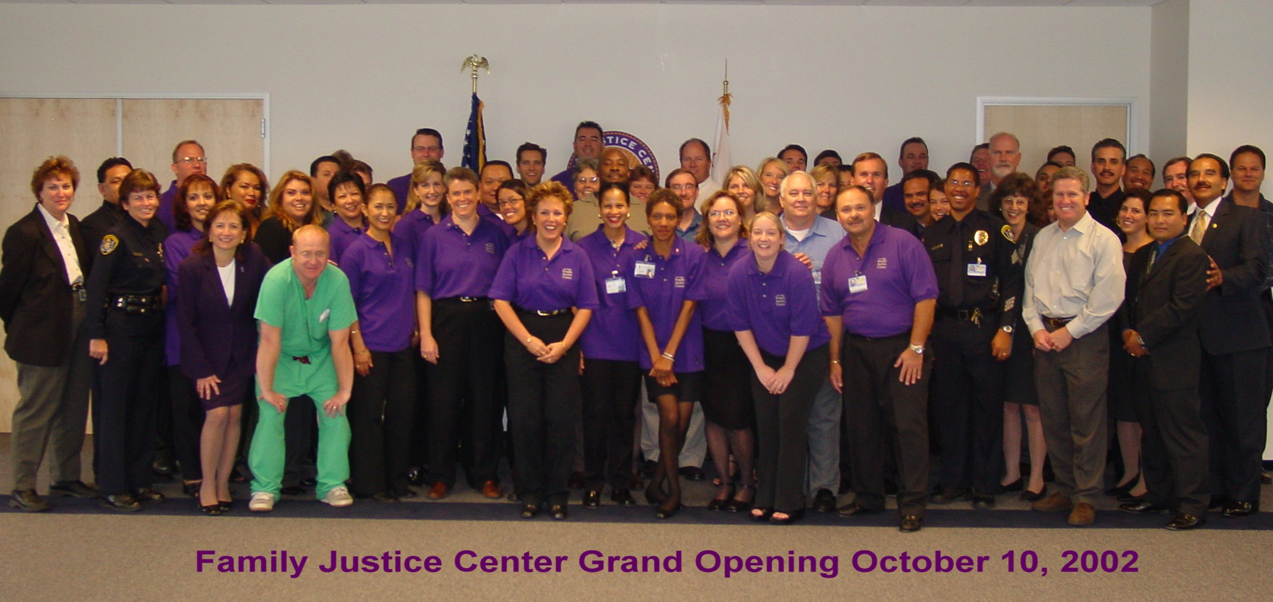
The Beginning of a Movement
Notes:
In 2002 the first Family Justice Center opened in San Diego by then City Attorney Casey Gwinn and Family Justice Center Director Gael Strack – serving over 1000 survivors and their families per month. Quickly word spread of the phenomenal work being done to prevent homicides and reduce recidivism in the City of San Diego catching the eye of President Bush’s Administration.

Slide 8
President’s FJC Initiative Announced in October 2003
Notes:
Then in October of 2003 President Bush announced the Presidents Family Justice Center Initiative – which provided more than $20 million dollars to open the first 15 Family Justice Centers in communities around the country.

Slide 9
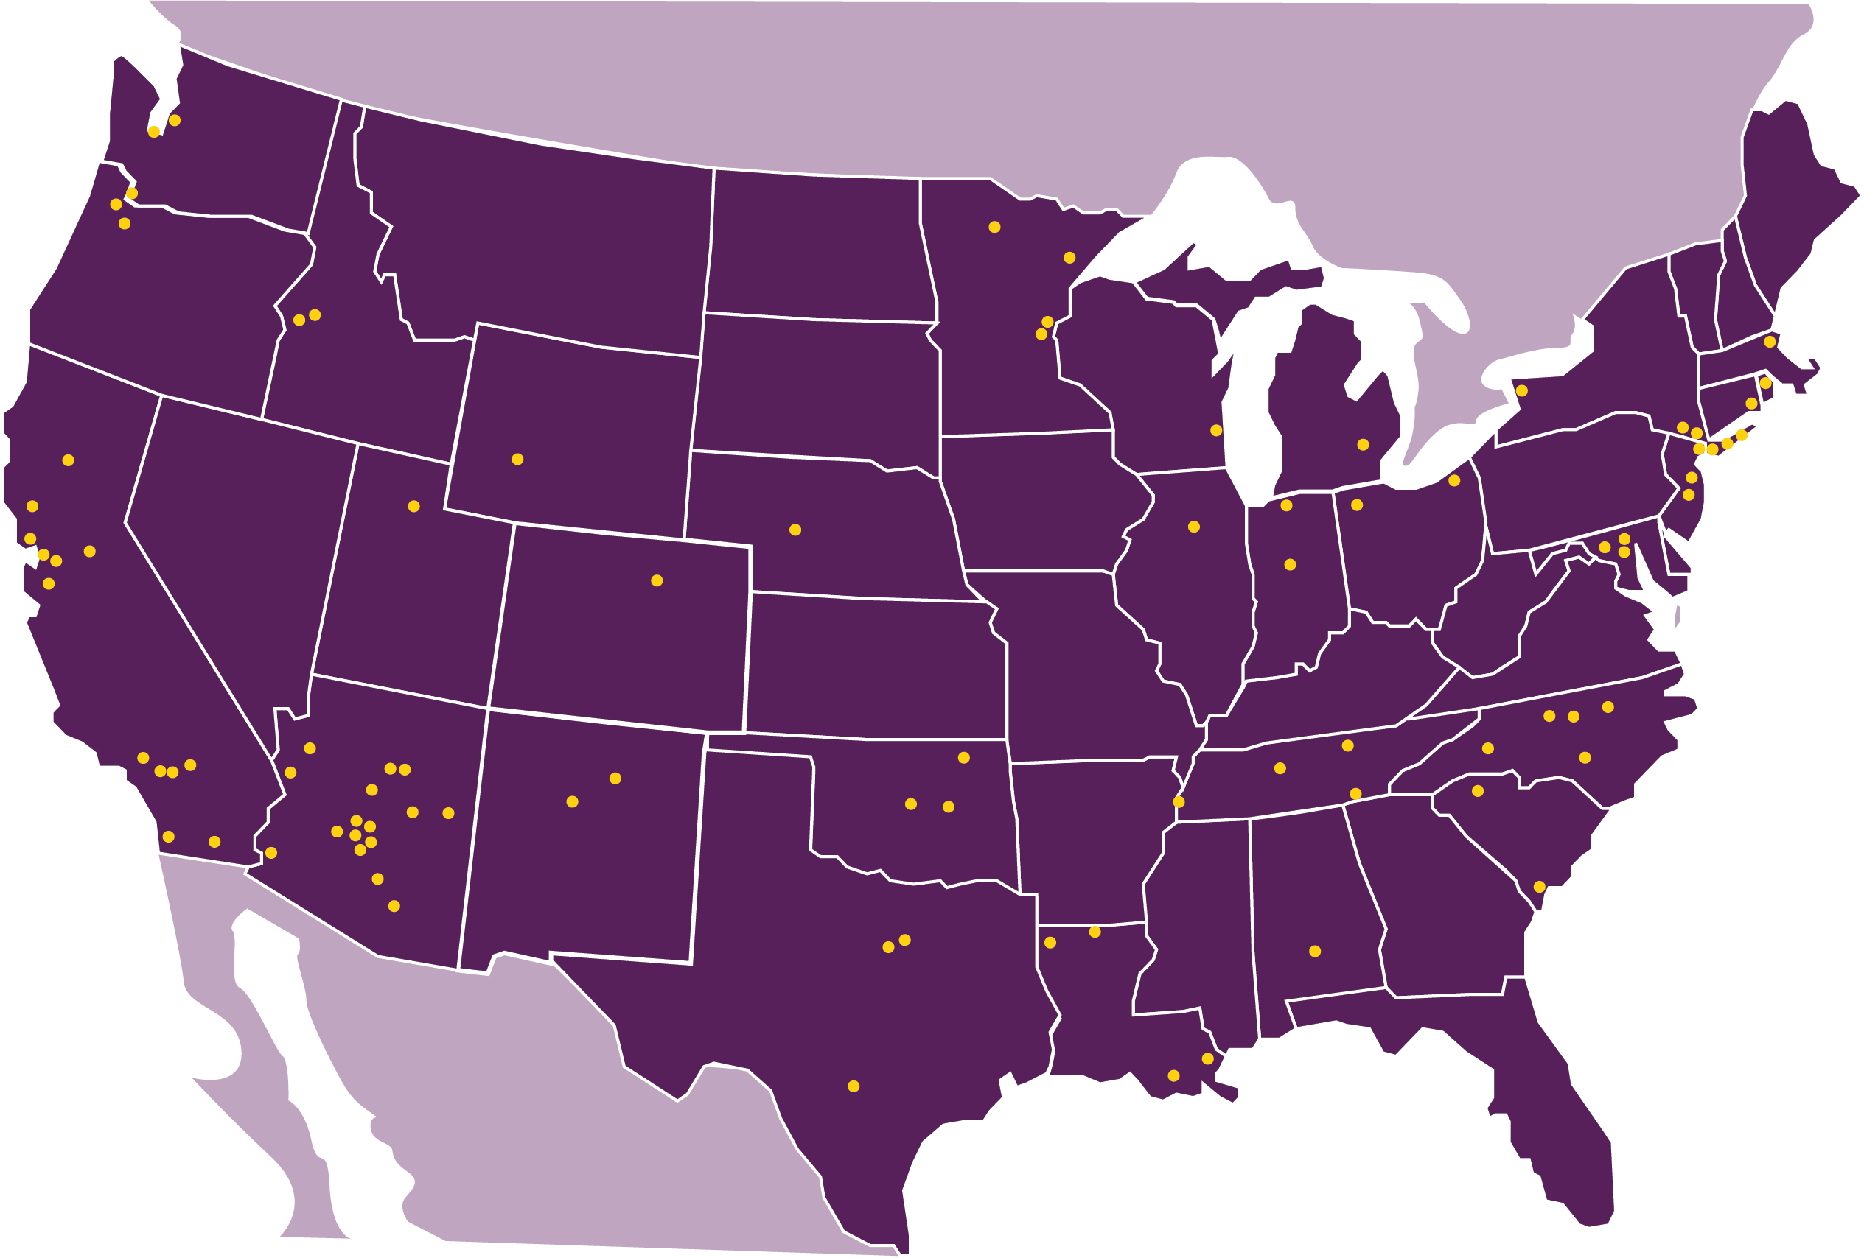
The Family Justice Center Movement
Notes:
Since the Presidents Family Justice Initiative the Family Justice Center movement has expanded rapidly.
An environmental scan funded by the National Institute of Justice demonstrates that there are over 137 Family Justice Center and similarly Multi-agency Models in the Country.
Alliance for HOPE International estimates that
½ coordinated by shelters/community-based DV/SA agencies
½ coordinated by District Attorney’s Offices or Police Departments or public agencies
Family Justice Centers exist in Rural, Suburban Urban and Tribal Communities across the country, uniquely reflecting the needs of their community. Family Justice Center serve survivors of domestic violence, sexual assault, child abuse, elder abuse, and human trafficking.

Slide 10
Maslow’s Hierarchy of Needs
Hope
Self-Respect, Agency, Healing
Connection, Support, Community,
Safety, Protection, Security
Food, Shelter, Clothing, Transportation
Notes:
Family Justice Centers are rooted in the belief that to break the cycle of violence in the life of ONE person – let alone several generations Maslow’s hierarchy of needs must be met during service delivery.
And as you may well know the basic principle behind Maslow’s hierarchy of needs is that you cannot address people’s needs of belongingness, and self-worth without addressing their BASIC physiological needs first (food, shelter, water, safety clothing and sleep).

Slide 11
Start Small
Family Justice Center
Dream Big
Advocacy
Law Enforcement
Prosecutor
and
Civil Legal Services
Counseling
Child Resource Room
Adult Therapy
MDT
Child Abuse and
Sexual Assault
Social Services
DCF
Housing Services
Cultural and Linguistic
Wellness Center
Mental Health Center
Interfaith Counseling
Meditation
Medical Forensic Medical Examination Room
Prevention
Self Sufficiency
Job Training
Dress for Success
Childcare
Camping and Mentoring
Adapted from:
The Center for Women and Families of Eastern Fairfield County, Inc.
11
Notes:
And under ONE ROOF Family Justice Centers do just that. They provide crisis intervention to address those physiological needs – and they also focus on the holistic needs of survivors and their families.
Through advocacy services, counseling, legal help, medical support, health and wellness, job training and self sufficiency training survivors and their families are wrapped with services increasing their chances of leaving the abusive relationship and breaking the cycle of violence.

Slide 12
Informed by Evaluation
2004 PFJCI Assessment Study
2007 Alameda 3 yr. Outcome Study
2007 San Diego FJC Study/Alliant Uni.
2008 Nampa FJC/Boise St.
2009 San Diego FJC Study/SD State Uni.
2009 Alameda County Comparison Study
2010 NYC FJC Outcomes Study
2013 California Evaluation
2015 Camp HOPE Research
2016 National Institute of Justice Scan
2016 Camp HOPE Research
2017 Family Justice Center HOPE Research
Notes:
And our outcomes and work has been informed by evaluation. Since 2004 Family Justice Centers have been pushing for research that shows the effectiveness of their work from changes in prosecution outcomes, to survivor defined success, to reduced number of domestic violence calls, increased collaboration and positive systematic changes for survivors and their families.

Slide 13
Multiple data sources to reflect multiple perspectives
Mixed methods data collection allows evaluation team to build rapport and trust with FJC staff and include perspective of victims / survivors
Buy-in from staff essential when they are key to data collection
FJC staff focus groups & online survey
Victim/survivor focus groups & self-recorded interviews (English & Spanish)
Administrative data from FJC sites (MIS, Criminal Justice)
Interviews with FJC directors
Systematic evaluator observations during site visit
Triangulation of data sources for same indicator enhances validity of the data
Notes:
One of the most exciting things about our evaluation is that we collected data in 5 different ways:
-Family Justice Center staff and partners participated, using both focus groups and an online survey
-From survivors, we gathered data through focus groups and self-recorded interviews – in both English and Spanish
-We also interviewed the 8 Family Justice Center directors
-From 4 of the sites, we gathered services information through their administrative data and we also gathered criminal justice data
-And we gathered data through observations and a walk-through that we did during site visits at all 8 sites.
We used this mixed methods data collection strategy as part of the collaborative, participatory evaluation approach.
The main advantage of this approach is our ability to enhance the worthiness or validity of the data by having data from so many different people and so many different sources.

Slide 14
Research shows Survivors WERE supported 5 ways
Supports for Access to FJC
Easy to come
High quality service provision
Survivors feel supported
Helpful referral sources
Other helpful qualities
Credit To:
EMT Associates, Inc.
Notes:
Through survivor interviews an independent 2013 California Family Justice Initiative Evaluation found that
Survivors access to family justice centers was supported in 5 key ways:
1. it was easy for survivors to come
2. They received high quality services– that was described in 3 ways:
-knowledgeable and friendly family justice center staff
-ability to get specialized help
-and fast effective service coordination
3. Survivors felt supported, encouraged, welcomed, protected and safe, comfortable, and not treated like a number
4. And because FJCs connect the criminal justice system with community based agencies survivors came into contact with a knowledgeable referral source such as court, a shelter, or police and this was linked to a smooth transition into family justice center services
5. In addition survivors felt FJCs were helpful because FJCS do not turning anyone away, have food available, easy parking and transportation assistance, all in a central location.

Slide 15
Drop in Homicides
Brooklyn FJC has served 19,972 clients in 2015 alone:
2002 – 36 homicides
2005 – Family Justice Center Opens
2010 – 27 homicides
2012 – 24 homicides – Borough wide FJC Initiative Announced
2013 – 26 homicides
2014 – 6 homicides
2015 – 3 homicides that is a 91.67% DECREASE
Notes:
And the numbers speak for themselves. In 2015 alone the Brooklyn Family Justice Center has served over 29,972 survivors and their families. Before opening the Family Justice Center in 2002, Brooklyn had 36 homicides. The Mayor’s Office to Combat Domestic Violence began to fund City wide Family Justice Centers in 2012 and since then DV Homicides in Brooklyn have dropped dramatically. In 2015, there were 3 DV Homicides a 91.67% decrease since 2002!

Slide 16
Drop in Homicides in San Diego…
Notes:
Similarly in San Diego there has been a steady decline of DV homicides since the Opening of the Family Justice Center in 2002.

Slide 17
Drop in DV Trials – 1st year in San Diego after the Family Justice Center opened
2002
81 jury trials
2003
24 jury trials
Notes:
Family Justice Centers have also led to a decrease in DV Jury Trials. In San Diego, there were 81 jury trials for domestic violence crimes – and in 2003 (just one year) that number was down to 24.

Slide 18
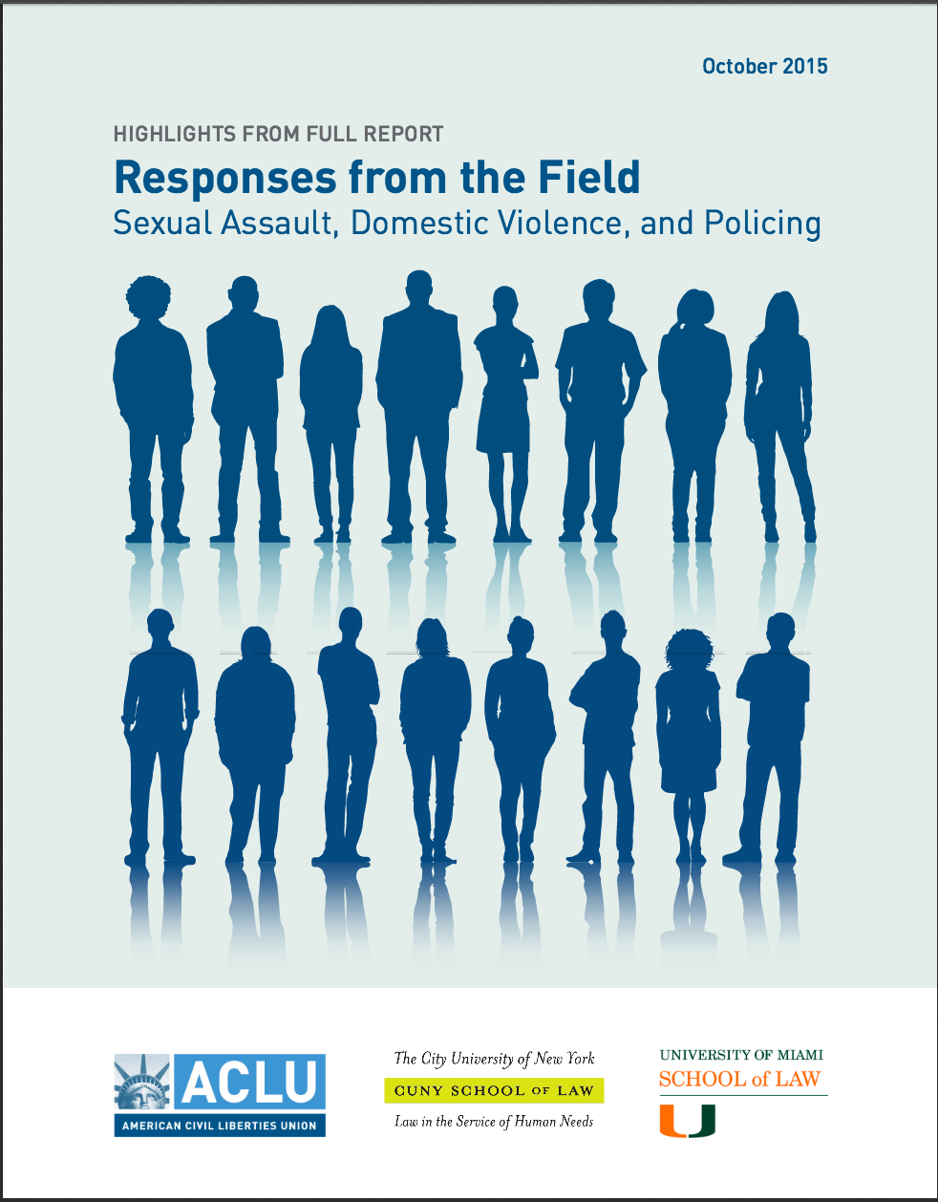
ACLU University of Miami Study
Notes:
As mentioned previously, Family Justice Centers have led to systemic changes in our communities. Though this ACLU report was not intended to focus on mitigating factors to police bias, advocates identified -- Co-located advocates and police officers, multi-disciplinary teams, and specifically Family Justice Centers as a critical way to mitigate police bias around the country.

Slide 19
Research on Children Exposed to Domestic Violence
75% of children became victims as adults
78.6% of children became perpetrators as adults
Notes:
http://dev.cjcenter.org/_files/cvi/Generation%20Cycles%20IPVforweb.pdf
http://dev.cjcenter.org/_files/cvi/Gang_Crime_Victimization_final.pdf
The National Youth Survey Family Study sampled 1,683 families and followed 353 second-generation parents and their third-generation offspring over a 20-year period and found that
75% of children exposed to DV became victims as adults
And
78.6% of children exposed to DV became perpetrators

Slide 20
Hope
Self-Respect, Agency, Healing
Connection, Support, Community,
Safety, Protection, Security
Food, Shelter, Clothing, Transportation
Notes:
Though these statistics are grim – Family Justice Centers have found ways to mitigate the impact of this Trauma.
Remember Maslow’s Hierarchy of Needs? Possibly most meaningful work of Family Justice Centers has been documenting the scientific changes of HOPE in survivors and their children through thoughtful and intentional programming in our Centers.
Hope is the single most important predictor of long-term outcomes in the lives of survivors. High hope people navigate their way through trauma better than low hope people. Using the Hope Index, we measure Hope before and after we work with children and adult survivors of violence and abuse.

Slide 21
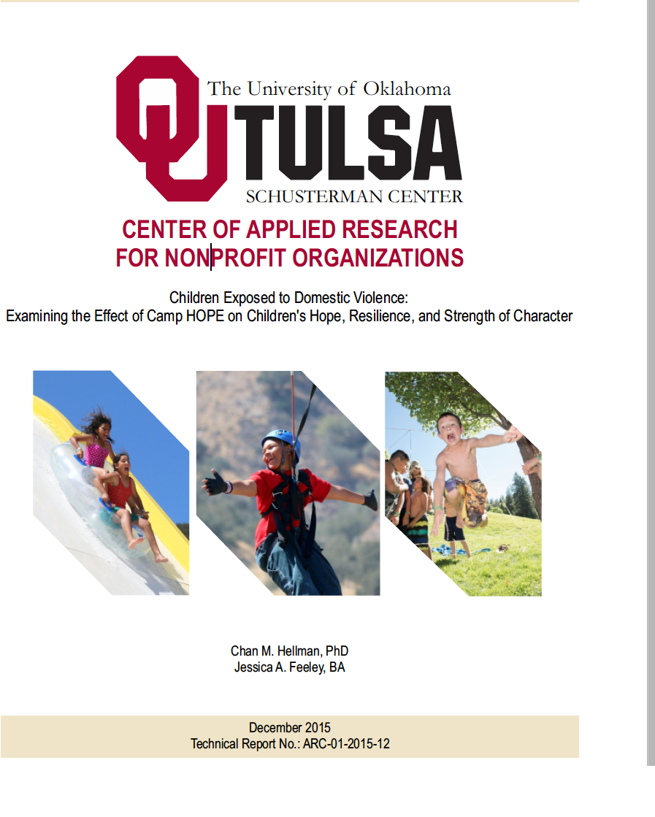
Camp HOPE a program in Family Justice Centers across the US.
Notes:
As we finalize the research for 2016 – I share with you some of the incredible changes in hope and resiliency we have seen in the children exposed to domestic violence we have seen through Family Justice Center programs like Camp HOPE.

Slide 22
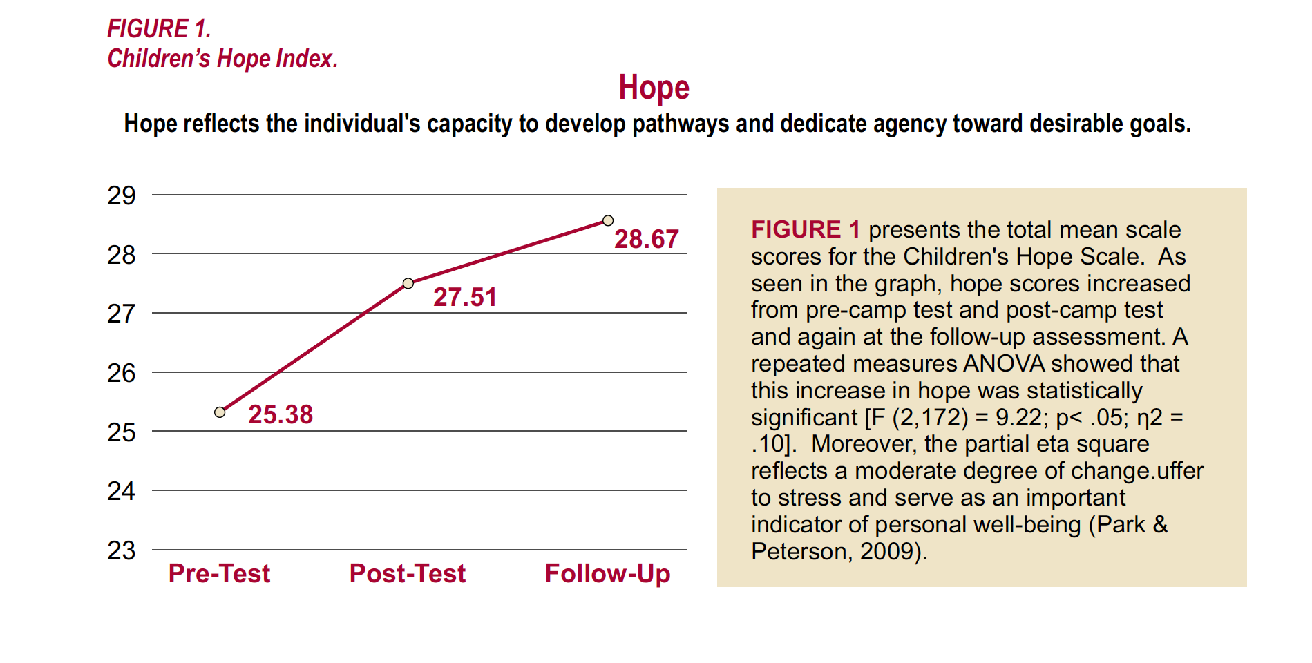
Children’s Hope Scale 2015
Notes:
The validated HOPE Index is conducted before camp – after camp, and 30 days after camp and we see that Children who participated in Camp HOPE had a statistically significant change in their level of HOPE.

Slide 23
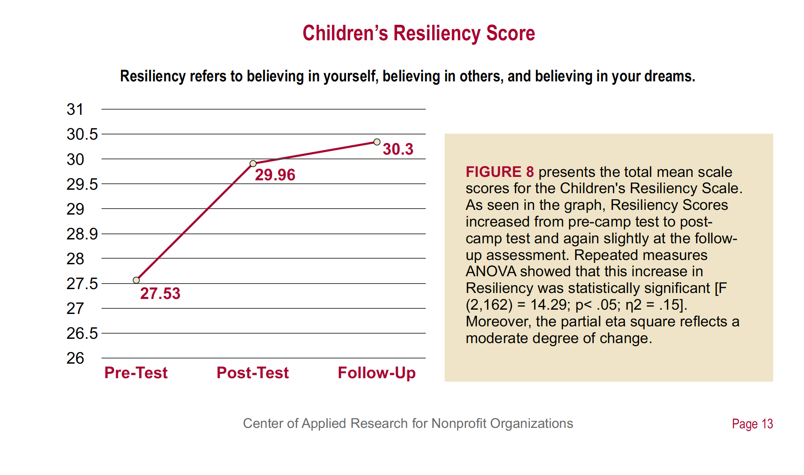
Resiliency Scores in 2015
Notes:
This includes a statistically significant increase in resiliency scores.
This year the research was published in the Child and Adolescent Social Work Journal further demonstrating the evidence based practices and effective programs implemented by Family Justice Center communities across the country.

Slide 24
Questions? Thank You!
Natalia Aguirre
Alliance for HOPE International
Natalia@allianceforhope.com
Notes:
It is through this comprehensive and holistic work that family justice centers continue to change the outcomes for survivors and their children and bring hope to communities.
Thank you! I believe there is a short time for questions

