Slide 1
Preventing Violence
Understanding and Addressing the Determinants of Violence in the United States
National Science Coalition to Improve Lives
July 22, 2015
Kristin Anderson Moore, Ph.D.

Slide 2
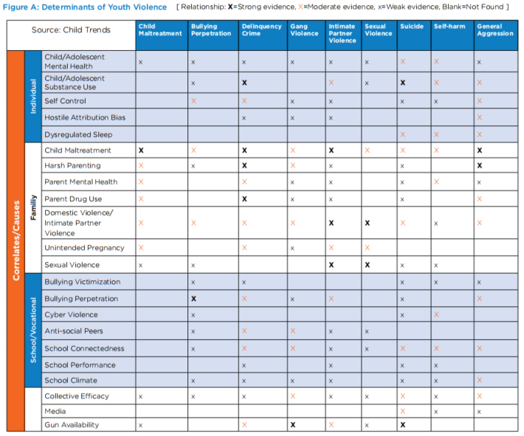
Determinants of Youth Violence

Slide 3
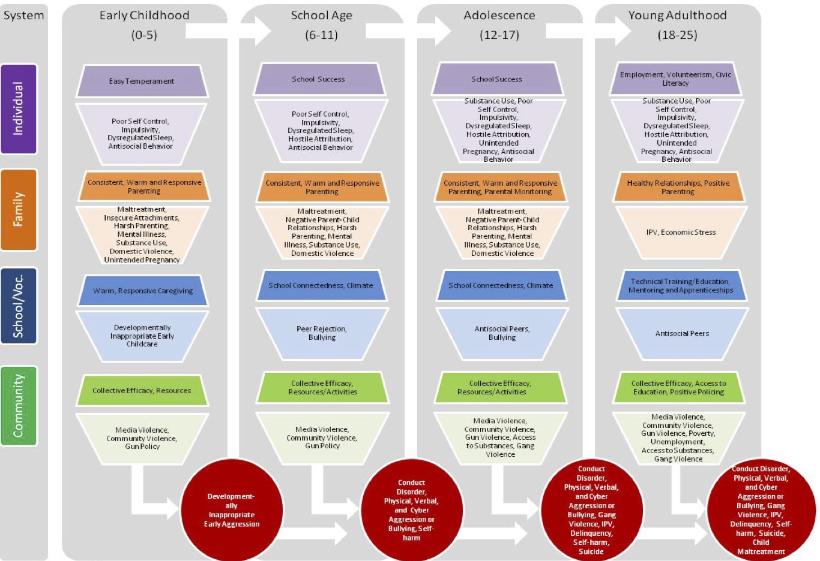
Risk and Protective Factors by System and Age

Slide 4
In sum:
There are common determinants of violence.
Addressing critical common determinants can have a range of beneficial effects.
We know the major risk and protective factors for violence,
…with the caveat that we need to better understand the societal, community, and cultural factors that are related to violence.
We need to not only tackle risk factors but also strengthen protective factors, like improving school climate and community.

Slide 5
Contact
Kristin Anderson Moore, Ph.D.
Senior Scholar, Child Trends
7315 Wisconsin Ave., Suite 1200W
Bethesda, MD 20814
240-223-9202
kmoore@childtrends.org
Follow us on Twitter
Find us on Facebook
Subscribe to our E-News

Slide 6
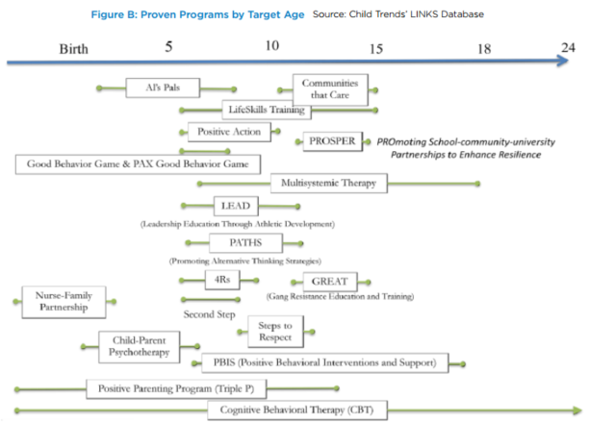
Proven Programs by Target Age

