Slide 1


Treatment of Opioid-Use Disorders: Pathways to Abstinence
Kenzie L. Preston, Ph.D.
Clinical Pharmacology and Therapeutics Research Branch
NIDA Intramural Research Program
June 24, 2016
Science = Solutions

Slide 2
Medications for Opioid Dependence
Methadone
Buprenorphine
Naltrexone
Naloxone
How can we improve treatment and prevent relapse?

Slide 3
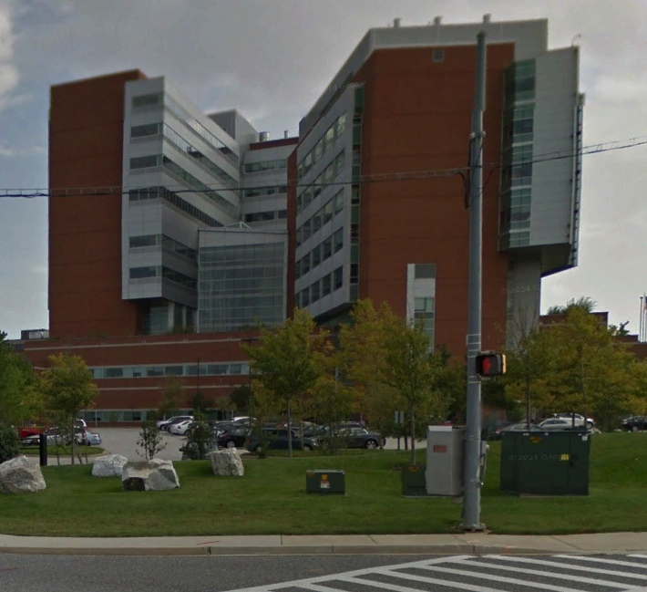




Outpatient Addiction Treatment Research Program
Behavioral and pharmacological treatment
Counseling by master’s level counselors
Medical monitoring
Pathways to Abstinence
Behavioral therapy
Medication for relapse prevention
Mobile health in addiction treatment

Slide 4
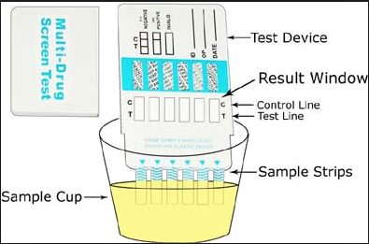
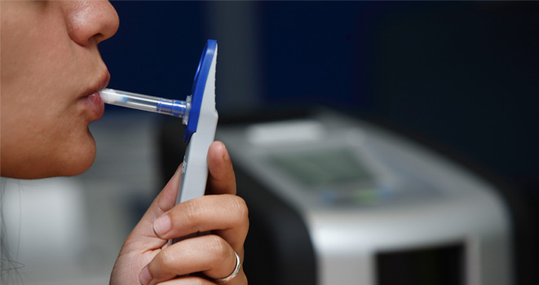
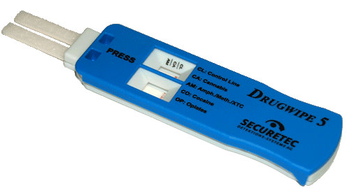
Behavioral Pathway: Contingency Management
Target behaviors are reinforced to increase their frequency.
A target behavior can be any behavior that can be monitored.
  In the context of drug abuse treatment, the target behavior is usually abstinence as indicated by a negative drug screen.
Many different things can serve as reinforcers.
Drug Screen
Urine
Negative test
Incentive
Prize/Voucher
Non-monetary
Breath
Oral Fluid
Positive test
Incentive

Slide 5
Contingent Reinforcement of Cocaine Abstinence in
Methadone Maintenance Patients
Mean Percent Cocaine Abstinence
100
Contingent Group (n=19)
Control Group (n=18)
80
* Significantly different (P<0.01)
60
*
*
*
*
*
*
*
*
40
20
0
1
2
3
4
5
1
2
3
4
5
6
7
8
9
10
11
12
Baseline
Voucher
Study Week
Silverman et al., 1996

Slide 6
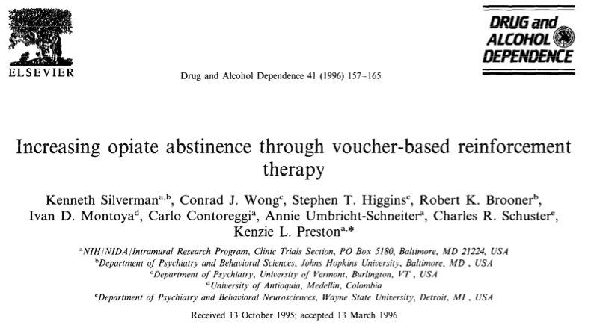
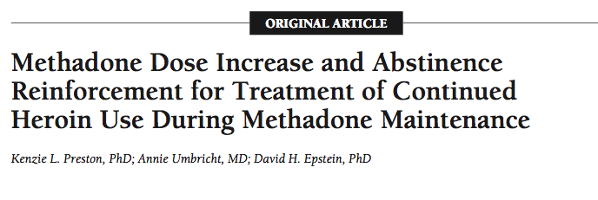
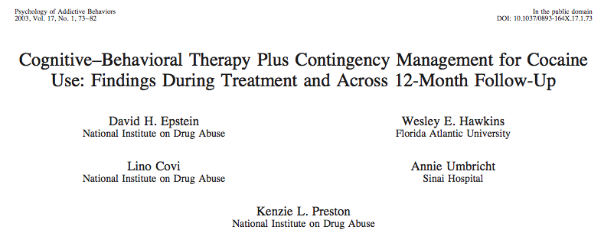
Contingency Management is effective
Opioid abstinence
In combination with medications
In combination with other behavioral treatments

Slide 7
Pharmacological Pathway:
Clonidine for Relapse Prevention
Clonidine blocks stress-induced drug seeking in an animal model of relapse.
Orally effective
Available - in clinical use for more than 40 years
Safe - Already used off-label in a drug-using population to treat opiate withdrawal symptoms
Does it work in the clinic?
Notes:
If we combine clonidine, which should block stress induced reinstatement with buprenorphine, which should block drug-primed reinstatement will we get an increase in the time to lapse, or relapse.

Slide 8

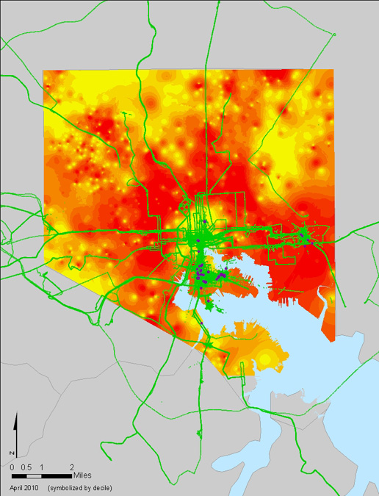
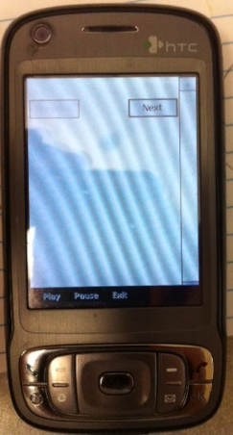

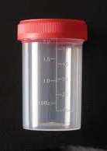
Randomized Clinical Trial
Clonidine for Relapse Prevention
Outpatient Treatment Research Program
Mobile
Technology
Opioid-dependent treatment seekers
Clonidine 0 mg vs. 0.3 mg/day
GPS – Real Time
Location
EMA – Real Time
Self Report
Geographical Momentary Assessment
Baseline
Intervention
Maintenance
Counseling
Buprenorphine
(8-24 mg SL)/d
Urine Drug Screen
3 per week
Contingent Vouchers
Clonidine/Placebo
1
3
5
7
9
11
13
15
17
19
21
23
25
27
weeks
Quit
deadline
Randomization

Slide 9
Results
Longest Duration of
Continuous Abstinence
Time to Lapse
100
80
Participants with no opioid lapse (%)
70
80
Clonidine
Placebo
60
60
Hazard ratio = .67
95% CI = .45 – 1.0
p =.05
50
40
Days of opioid abstinence
*
40
30
20
20
10
Induction
Intervention
0
0
0
Placebo
Clonidine
14
28
42
56
70
84
98
t₍₁₀₉₎=2.04, P≤0.05
Days of clonidine/placebo
Individual participant
Does it work?
  Yes. Clonidine given in conjunction with buprenorphine increased time to lapse and duration of abstinence.
How does it work?

Slide 10
Ecological Momentary Assessment
In the past hour did you see heroin? (yes/no)
Right now, do you crave heroin?
Right now, are you stressed?
  NO!!
  no??
  yes??
  YES!!
Asked at four randomly prompted times during participant’s waking hours

Slide 11
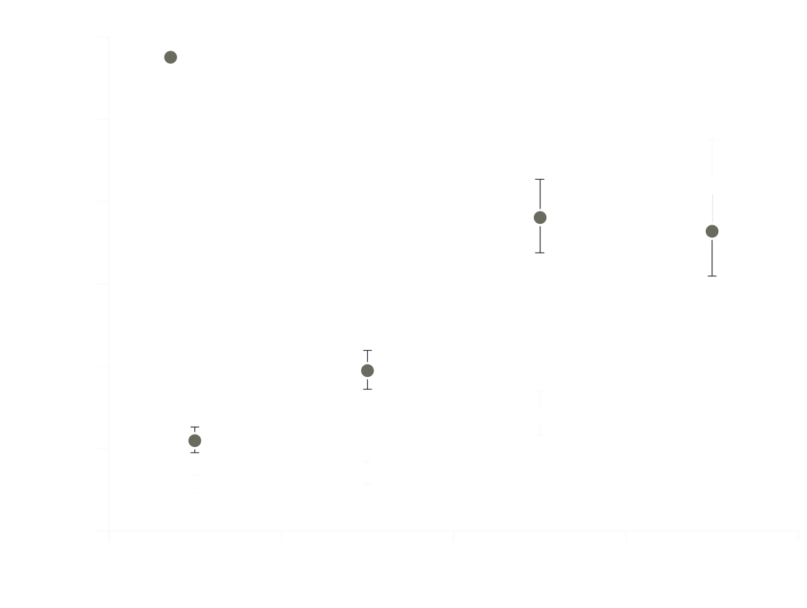
Results
Stress and Heroin Craving
30
Main effect of stress
(F_{(3,257)}=65.6, P≤0.001)
25
20
Likelihood of reporting
heroin craving (%)
15
*
10
5
0
Stress Rating
Notes:
First thing you see is that stress is a main effect of stress on craving. Higher stress Higher craving.

Slide 12
Results
Stress and Heroin Craving
30
Drug X Stress interaction
(F_{(3,257)}=8.8, P≤0.001)
25
20
Likelihood of reporting
heroin craving (%)
15
*
10
5
0
Stress Rating
  How?: Stress and craving were decoupled by clonidine.
Notes:
Most importantly there is a drug by stress interaction. Such that at lower levels of stress there is less craving in the clonidine group. And it is only when participants get to this extreme YES! level of STRESS that the two groups are equal on craving. The idea here is that AT lower levels of stress Clonidine succeeds in decoupling stress and craving, However it is not strong enough to over come Extreme lebvels of stress.

Slide 13
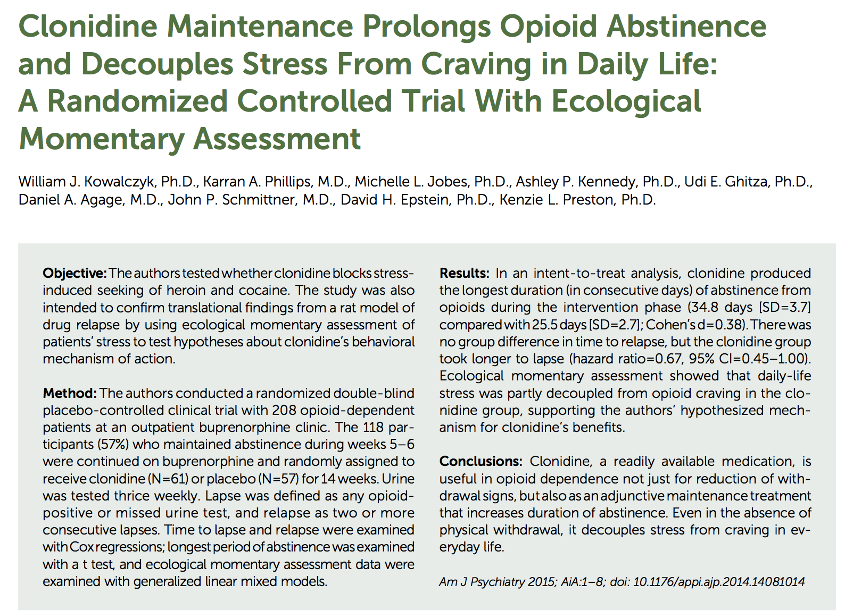

Slide 14
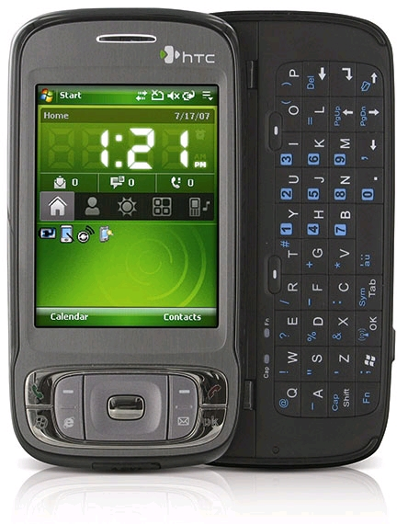

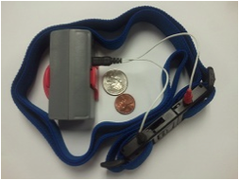
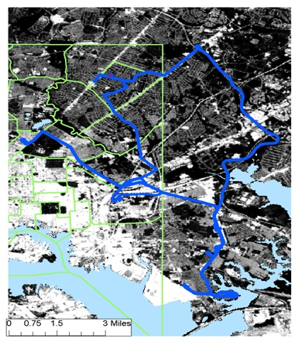
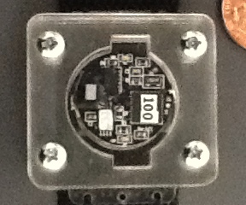
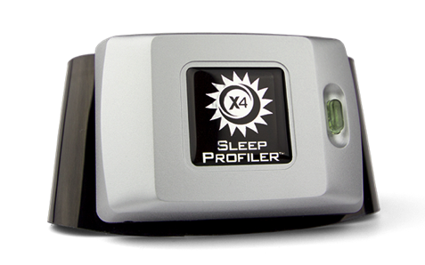
Pathways on the horizon: Mobile Health
Mood and Behavior
Location
Biosensors
Cocaine Craving
Cocaine
Cocaine Use
80
70
Craving Events
60
Use Events
50
Frequency
40
30
20
10
Time of Day
0
6am
8am
10am
12pm
2pm
4pm
6pm
8pm
10pm
12am
2am
4am
Time of Day
Notes:
14

Slide 15
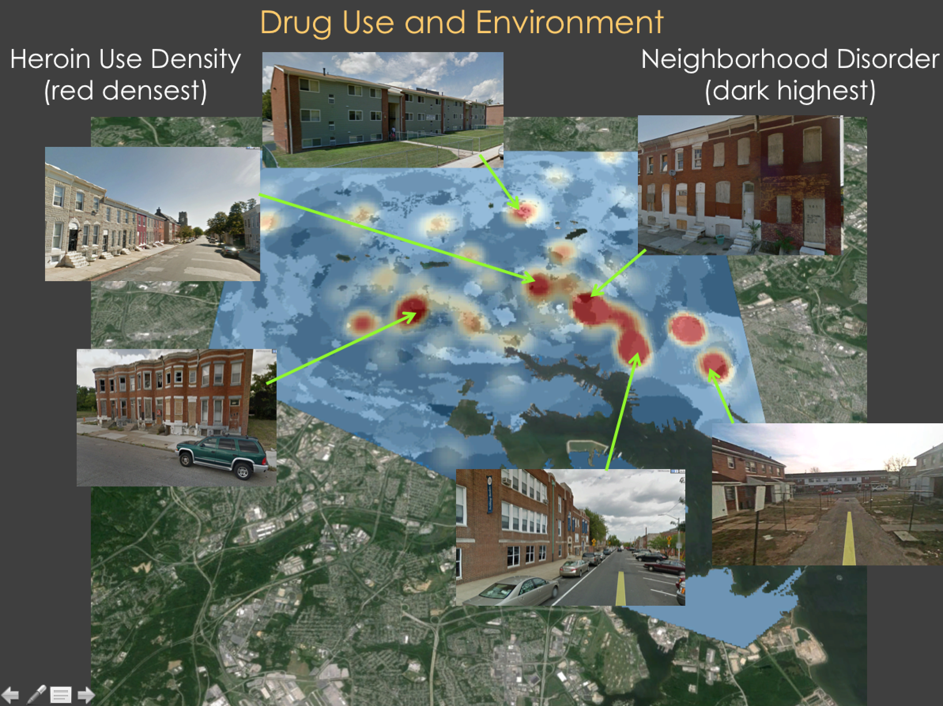

Slide 16
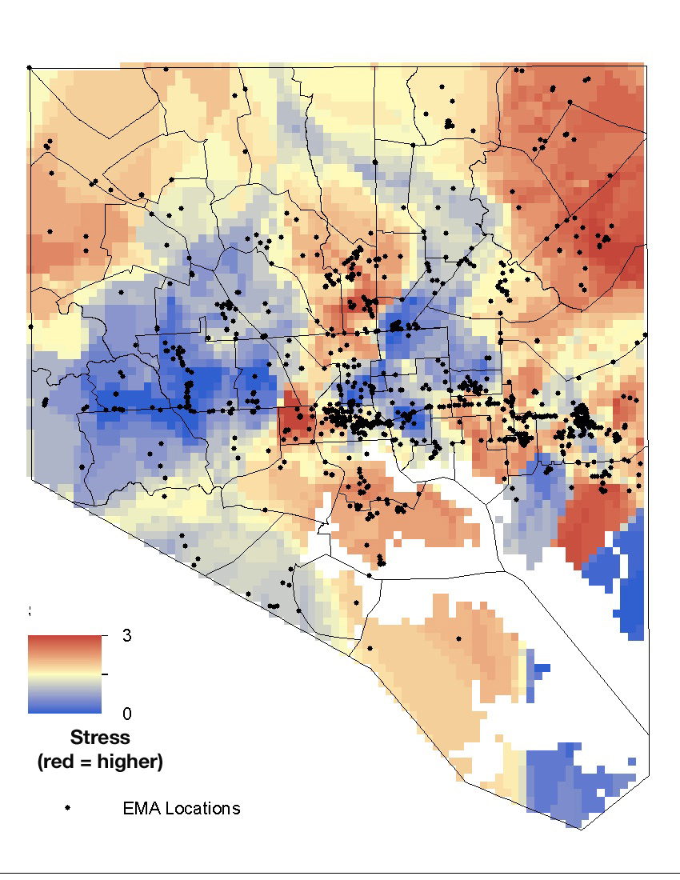
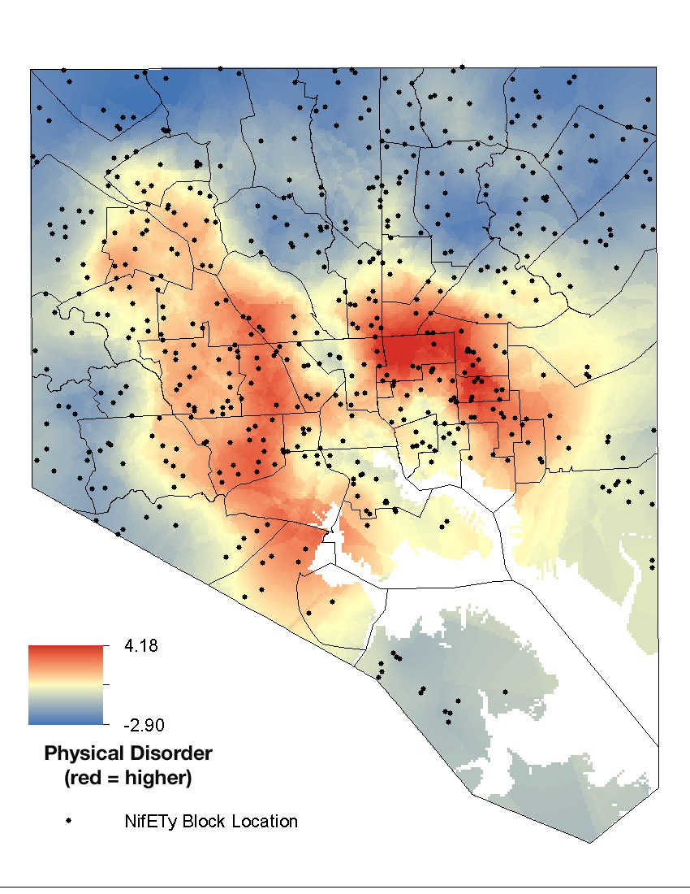
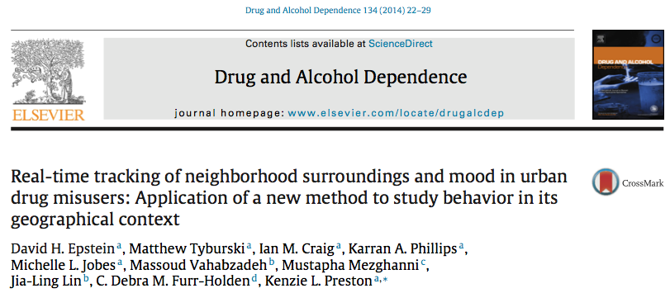
Understanding Mood and Environment
Self-Reported Stress
Neighborhood Disorder
Significant associations between mood and environment
Notes:
greater stress, negative mood, and craving in areas with less physical disorder and drug paraphernalia

Slide 17
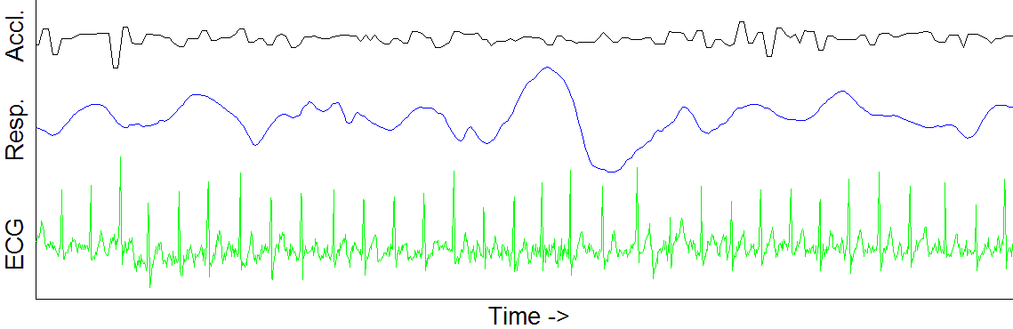
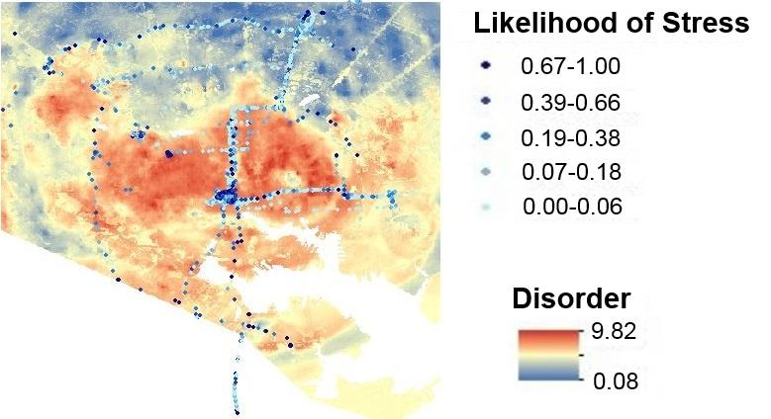
Physiological Response and Environment
AutoSense
Sarker et al., 2016

Slide 18
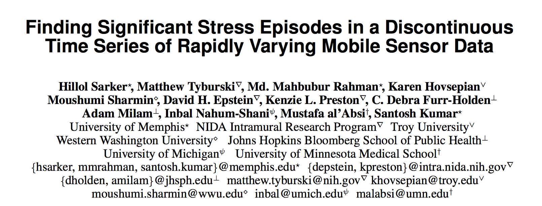
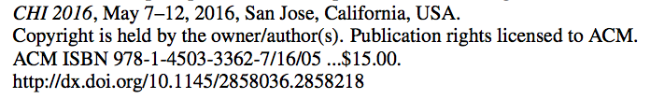

Slide 19
Goal: Mobile Just-In-Time Treatment Delivery
Stressed
Craving
Drug Use

Slide 20

Questions?

