Slide 1


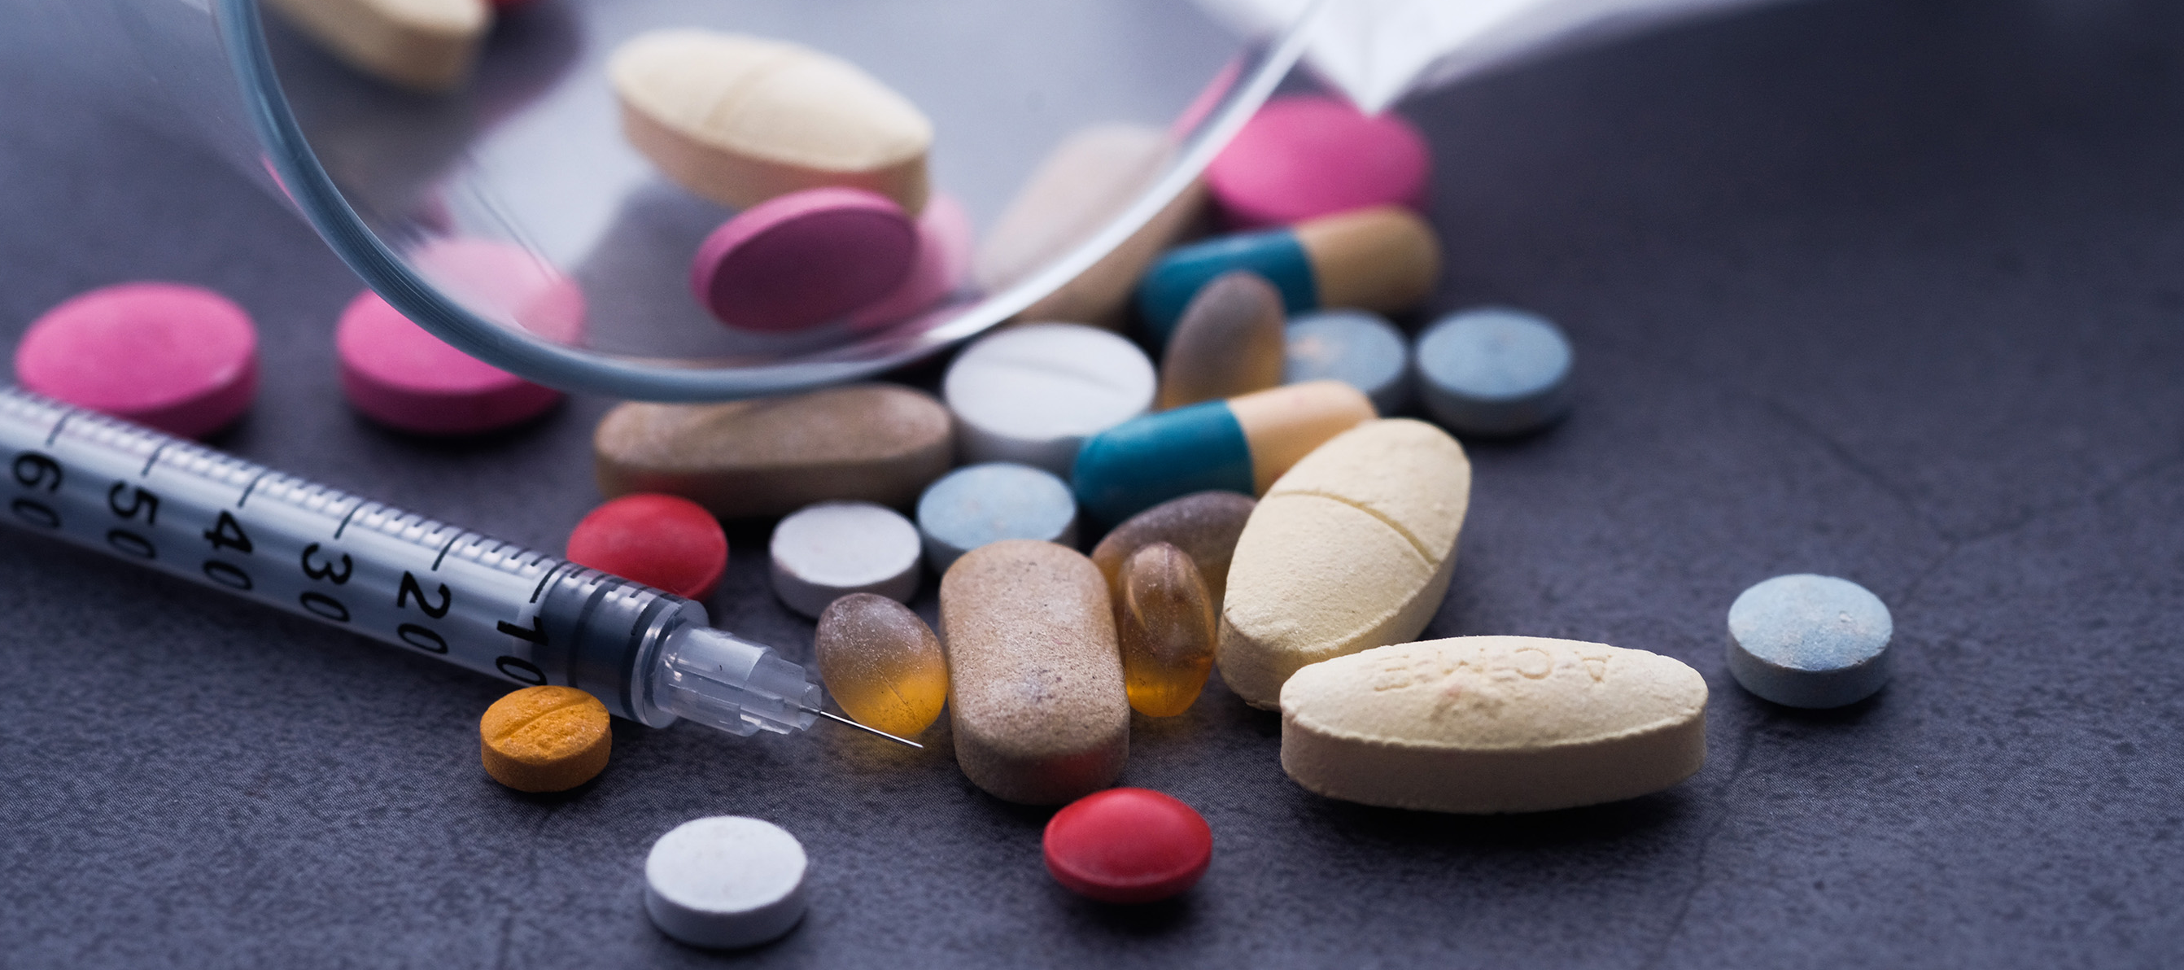
Making the Case for Prevention
The Real Dangers of Equating Opioid Dependence with Addiction
Phillip W. Graham, DrPH
Center on Social Determinants,
Risk Behaviors & Prevention Science
RTI International

Slide 2


Present
1991
2017
 |  |  |  | 
 |  |  |  | 
 |  |  |  | 
 |  |  |  | 
 |  | 
* Actually 2017 data
 |  |  |  | 
Phillip W. Graham, DrPH
Center on Social Determinants,
Risk Behaviors & Prevention Science
RTI International
5/100,000
2019*
Notes:
Here’s why.
[CLICK TO MAKE 1991 PEOPLE APPEAR]
In 1991, more than 13,000 people in the US died from poisonings, the majority of which were drug poisonings, or drug overdose. That’s 5 people for every 100,000 in the population.
[CLICK TO MAKE 2017 PEOPLE APPEAR]
In 2017, the most recent year for which we had data, about 23 people per 100,000 died from poisoning, and we know that nearly 22 of those were due specifically to drug poisoning.
So, this is the problem. People are dying from drug overdose at nearly 5 times the rate they were a few decades ago. (Talk about why that is…e.g., more addictive pharmaceuticals (←Phillip, confirm that this is true), more potent drugs like fentanyl)

Slide 3

1991
2017
 |  |  |  | 
 |  |  |  | 
 |  |  |  | 
 |  |  |  | 
 |  | 
5 / 100,000
23 / 100,000
 |  |  |  | 
Notes:
Here’s why.
[CLICK TO MAKE 1991 PEOPLE APPEAR]
In 1991, more than 13,000 people in the US died from poisonings, the majority of which were drug poisonings, or drug overdose. That’s 5 people for every 100,000 in the population.
[CLICK TO MAKE 2017 PEOPLE APPEAR]
In 2017, the most recent year for which we had data, about 23 people per 100,000 died from poisoning, and we know that nearly 22 of those were due specifically to drug poisoning.
So, this is the problem. People are dying from drug overdose at nearly 5 times the rate they were a few decades ago. (Talk about why that is…e.g., more addictive pharmaceuticals (←Phillip, confirm that this is true), more potent drugs like fentanyl)
Spend more time understanding all the paths to addiction
Spend more time understanding SDoH
Spend more time understanding upstream factors
Spend more time understanding poly drug use

Slide 4

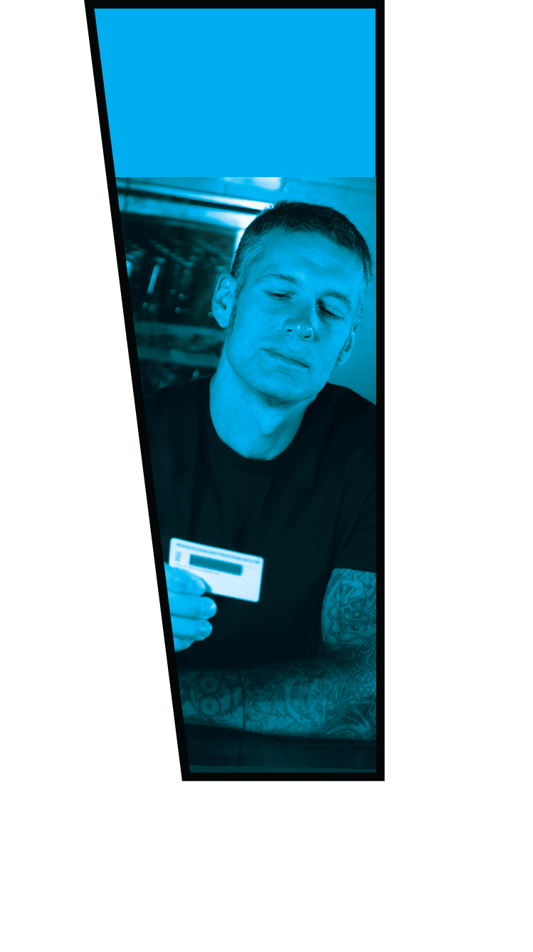
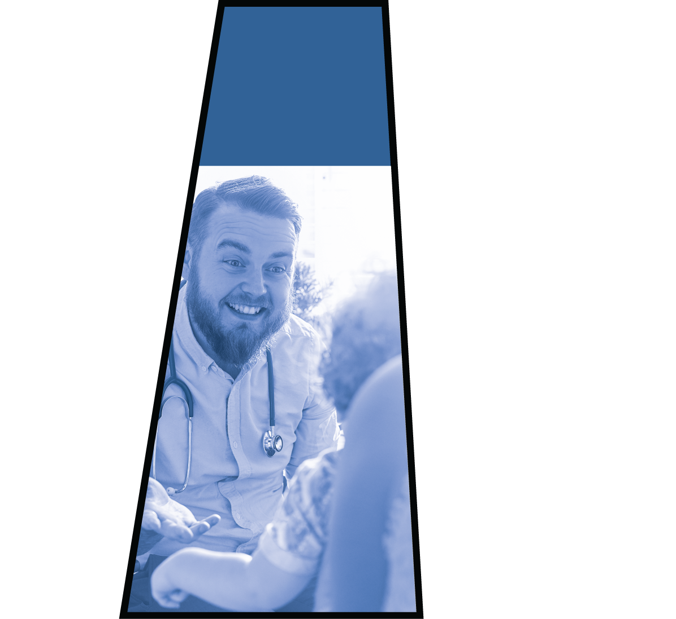

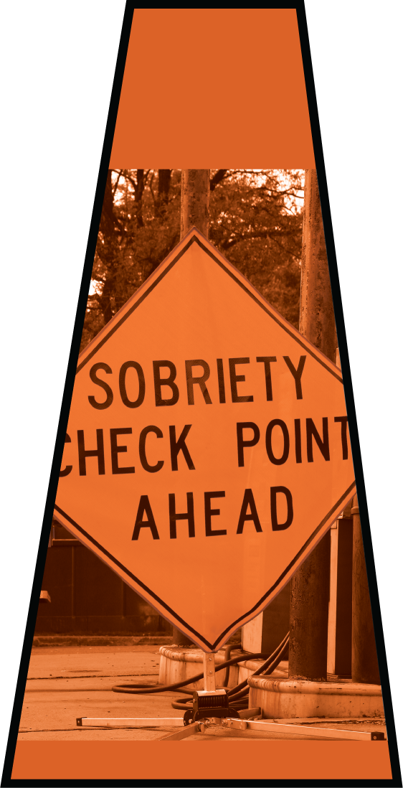
1991
Present Efforts
2017
5 / 100,000
23 / 100,000
Notes:
And today, after nearly three decades of research, we have dozens of substance use prevention strategies that have shown to be effective.
But, there are two problems. First, almost all of the evidence-based prevention strategies were tested before opioids became a major problem. So, few evaluations tested impact on opioids.
And we still don’t know much about the pathways to addition.

Slide 5
25,000
20,000
15,000
10,000
5,0000
Present
250
200
125
100
50
Number
of articles
2019
“opioid prevention”
Notes:
To quantify the problem for you, when you go to Google Scholar and search the term “opioid prevention,” it returns 212 articles.
When you search “opioid treatment”….

Slide 6
Present
25,000
20,000
15,000
10,000
5,0000
Number
of articles
2019
“opioid prevention”
“opioid treatment”
250
200
125
100
50
Notes:
…it returns more than 23 thousand. [exact number is 23,500, on 7/5/19)

Slide 7
Present
2019
Notes:
Because of the rising death toll from drug overdose, funders are putting a lot of money behind the opioid epidemic.
In Fiscal Year 2018, Congress appropriated more than $7 billion to address the opioid epidemic. About half of that went to SAMHSA, but the remaining funding was spread over 11 other agencies.
This funding doesn’t count state and local appropriations, or contributions by private corporations or philanthropic organizations.
[FROM TABLE 2 OF https://bipartisanpolicy.org/wp-content/uploads/2019/03/Tracking-Federal-Funding-to-Combat-the-Opioid-Crisis.pdf]

Slide 8
Future
Present
2019
2025
Notes:
To date, almost all opioid funding has gone into treatment. Unfortunately, drug poisoning deaths have continued to go up. So, what is it going to take for the rate of deaths to go down?
[CLICK TO SHOW DASHED LINE]
The only way we’re going to start bringing down overdose rates is through early prevention efforts.
These efforts need to address the risk and protective factors for starting opioid use. And, the good thing is that all of the different drugs out there have a lot of risk and protective factors in common. So, if you address risk and protective factors for opioids, it will likely have spillover effects for other drugs.
Spend more time understanding all the paths to addiction
Spend more time understanding SDoH
Spend more time understanding upstream factors
Spend more time understanding poly drug use

Slide 9
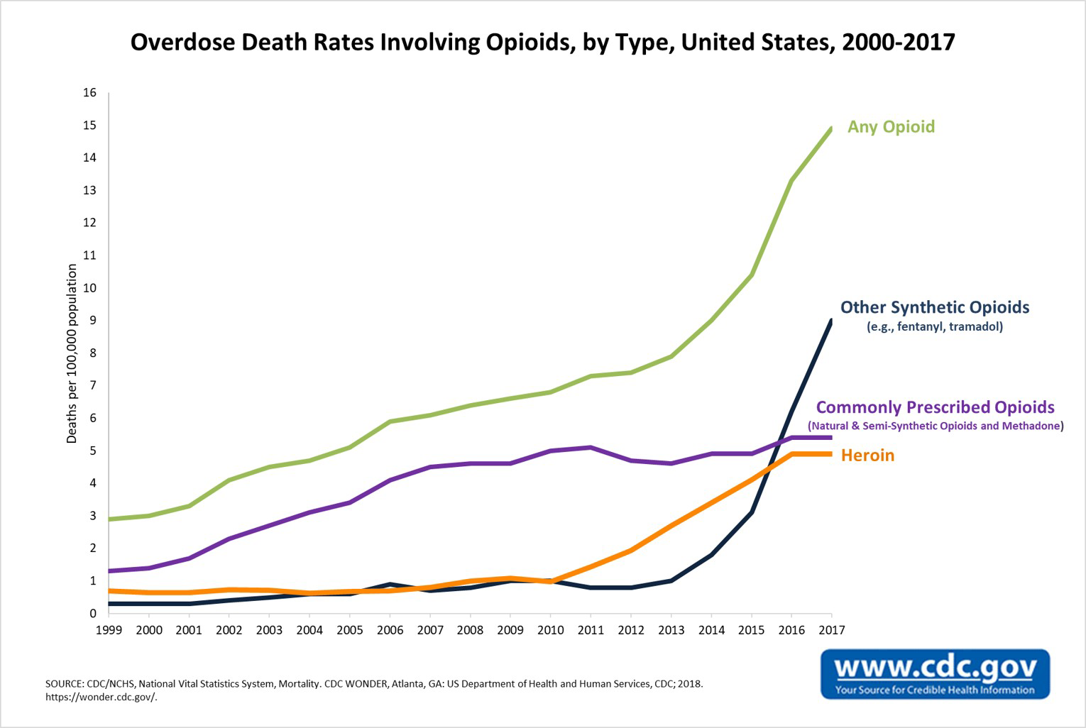

Waves 1, 2, 3
Overdose Death Rates Involving Opioids, by Type, United States 2000-2017
Any Opioid
Deaths per 100,000 population
Other Synthetic Opioids
(e.g., fentanyl, tramadol)
Commonly Prescribed Opioids
(Natural & Semi-Synthetic Opioids & Methadone)
Heroin
2019

Slide 10
Fourth & Fifth Waves
1
2
3
4
5

Slide 11
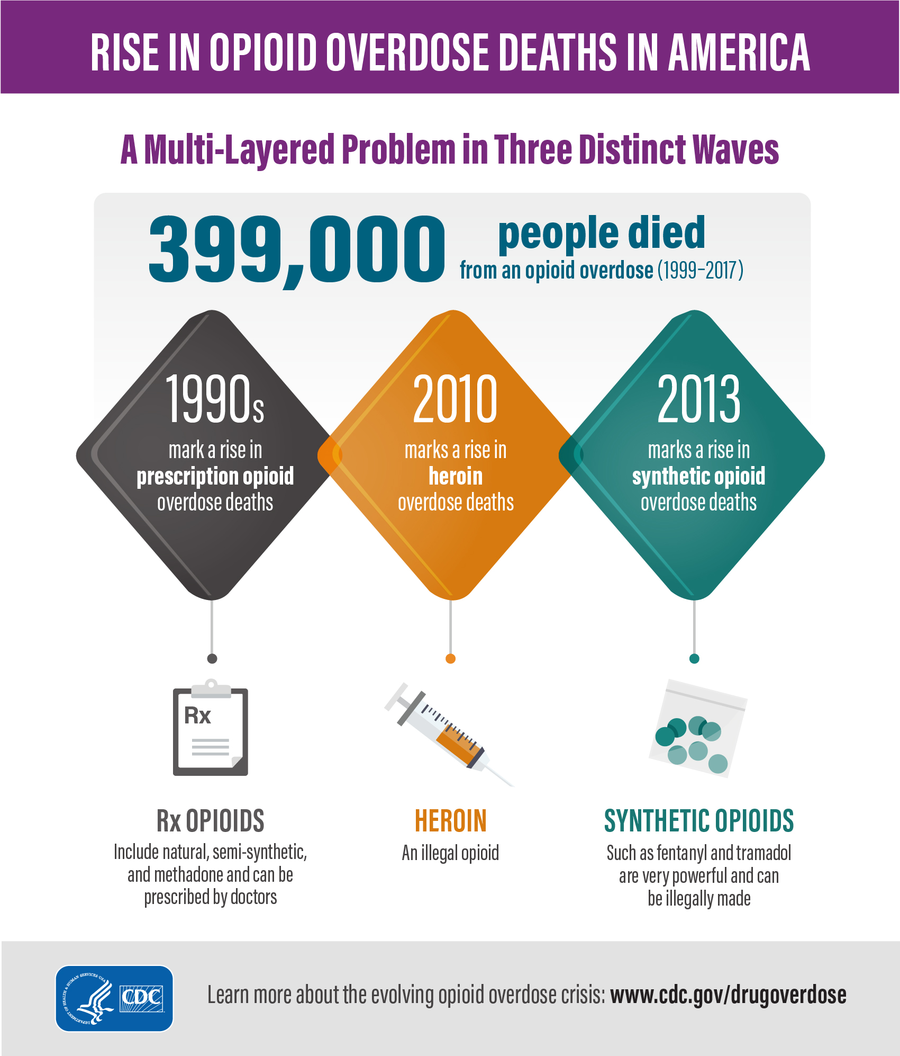

Fourth Wave| Next Drug Up
1
2
3
4
5
12,122
17,258

Slide 12

A Rise in overdose deaths in America | Fourth Wave
From 2015 to 2016
Cocaine-involved
Death Rates
Psychostimulant-involved
Death Rates
52.4%
33.3%
2019
Notes:
In 2017, the rates of overdose deaths involving cocaine increased by more than 34 percent. The rate of overdose deaths involving psychostimulants increased by more than 33 percent.
Drug overdose deaths involving cocaine, psychostimulants with abuse potential (psychostimulants), or both substances combined increased 42.4% from 12,122 in 2015 to 17,258 in 2016.*

Slide 13
Rise in opioid overdose deaths in America | Fifth Wave
1
2
3
4
5
52.4%
17,258
33.3%
12,122
2019
Notes:
In 2017, the rates of overdose deaths involving cocaine increased by more than 34 percent. The rate of overdose deaths involving psychostimulants increased by more than 33 percent.

Slide 14
Deaths involving synthetic opioids…
From 2016 to 2017
Highest death rate: Males aged 25-44 years
Largest relative increases: American Indian/Alaska Native
Largest relative increases: Blacks
27.0/100,000
60.7%
58.5%
Notes:
Deaths involving synthetic opioids increased from 2016 to 2017 across all demographic categories.
The highest death rate was in males aged 25–44 years (27.0 per 100,000), and the largest relative increases occurred among blacks (60.7%) and American Indian/Alaska Natives (58.5%).
In 2017, the rates of overdose deaths involving cocaine increased by more than 34 percent. The rate of overdose deaths involving psychostimulants increased by more than 33 percent.

Slide 15


Future
2019
Notes:
How do we support the role of prevention to address the current epidemic and future epidemics?

Slide 16

And how do communities leverage funding from settlements?
Notes:
RESEARCH FUNDING
So, once you’ve gotten a seat at the opioid table, what should you do when you’re there?
First, we need funding to conduct more research on opioid prevention. This includes funding to test time-tested strategies to see if they’re effective for opioids and other emerging substances, as well as funding to test new strategies that have been developed.
Talk about implementation science—by a show of hands—how many know this and related terms.

Slide 17
Making the Case
Tell the prevention story
Notes:
TELL THE PREVENTION STORY
Our job is to bring the work to life but not with anecdotes but with empirically based prevention stories.
Communities and local decision-makers should identify a research partner that understands community, uses plain language, and understands local conditions and context
[INCLUDE POINTS ABOUT RESEARCHER/PRACTITIONER COMMUNICATION/COLLABORATION]
Include references to better dissemination, improve researcher/practitioner communication…or should that be a separate point?

Slide 18

Making the Case
Research funding
Notes:
RESEARCH FUNDING
So, once you’ve gotten a seat at the opioid table, what should you do when you’re there?
First, we need funding to conduct more research on opioid prevention. This includes funding to test time-tested strategies to see if they’re effective for opioids and other emerging substances, as well as funding to test new strategies that have been developed.
Talk about implementation science—by a show of hands—how many know this and related terms.

Slide 19

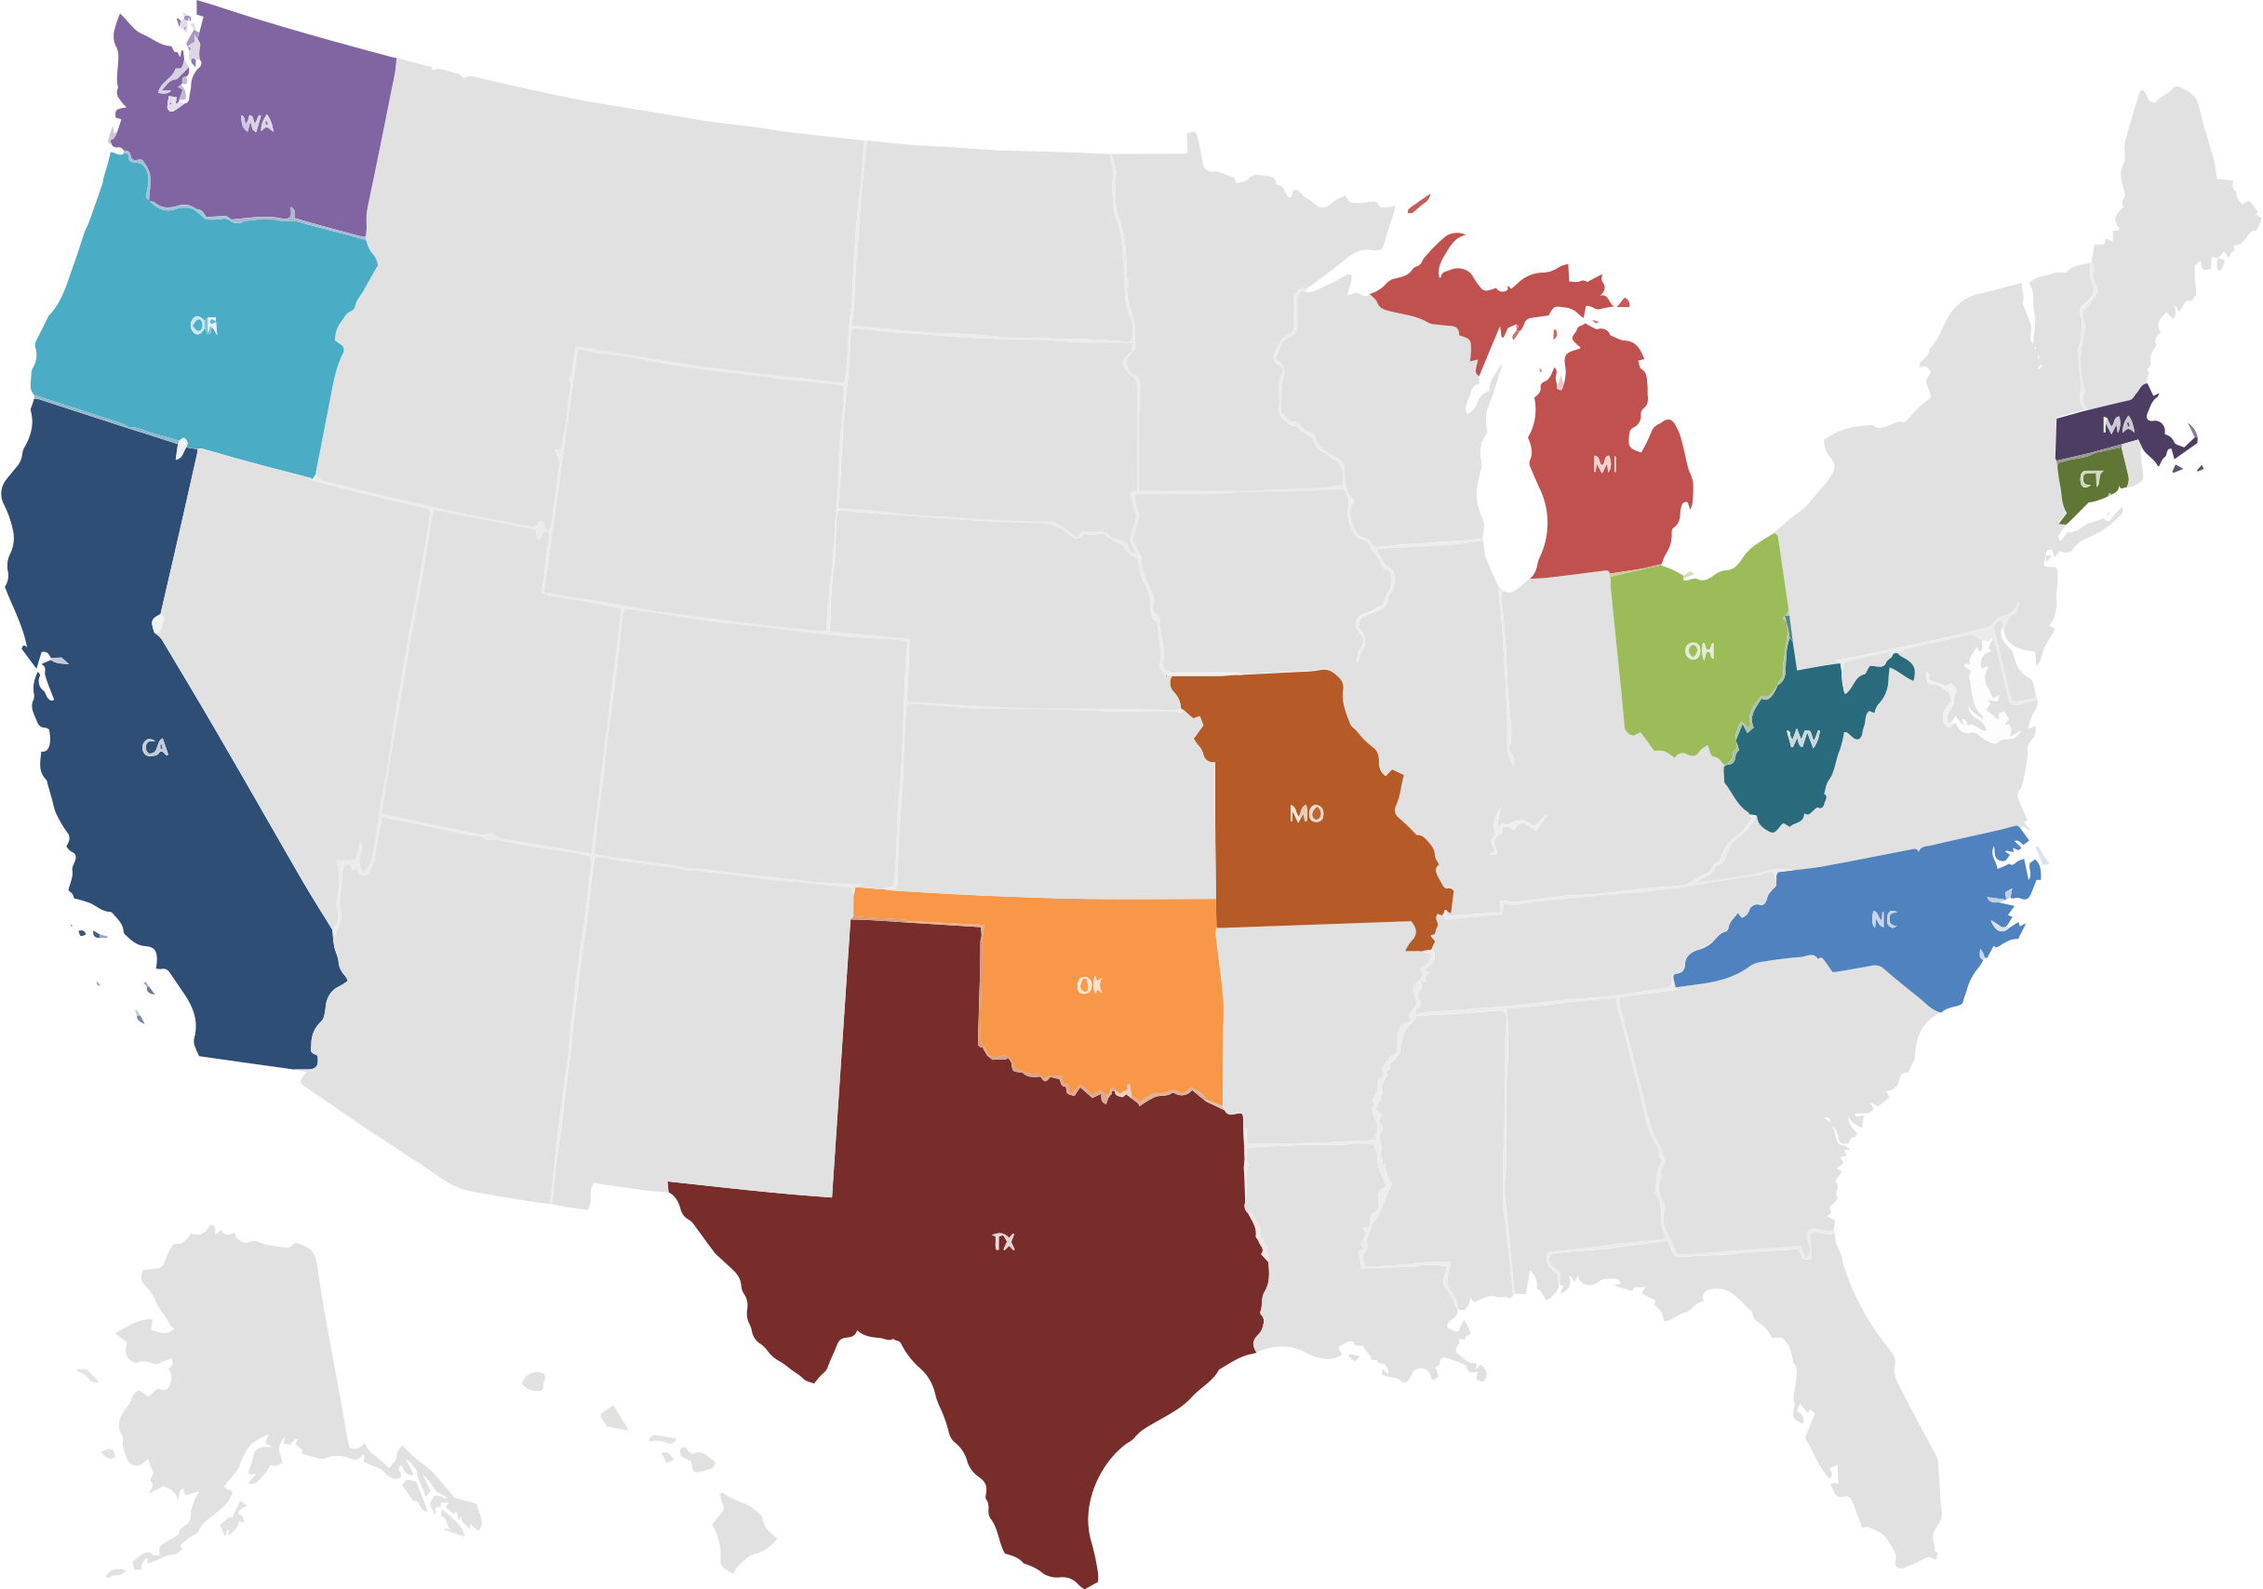
Getting to the Table
HEAL Prevention Initiative
Notes:
The HEAL Prevention Initiative is a step in the right direction. Ten research projects were funded to establish evidence-based interventions (EBIs) to prevent initiation of opioid misuse and development of OUD in at-risk older adolescents and young adults (AYAs) ages 16-30. Produce EBIs that can be adopted and implemented in systems and settings where individuals and populations most affected can be reached and provided prevention interventions.

Slide 20
Getting to the Table
HEAL Prevention Initiative
Indigenous & Vulnerable Populations
AI/AN – Urban
Healthcare Settings
ED based identification and tailored brief intervention delivered by remote health coach
Systems (Justice & Human Services)
Caring adult relational intervention for youth transitioning out of detention
Evaluate impact of treatment for psychopathology and SUD on development of OUD and other SUDs
AI/AN – Rural
Video game intervention delivered through school-based health centers
Adolescent Community Reinforcement Approach with Assertive Community Care for justice involved youth
Homeless youth – housing + preventive services
Child welfare involved families – multicomponent intervention for parents
At-risk rural young adult parents

Slide 21
And what might this look like in practice??
Notes:
RESEARCH FUNDING
So, once you’ve gotten a seat at the opioid table, what should you do when you’re there?
First, we need funding to conduct more research on opioid prevention. This includes funding to test time-tested strategies to see if they’re effective for opioids and other emerging substances, as well as funding to test new strategies that have been developed.
Talk about implementation science—by a show of hands—how many know this and related terms.

Slide 22
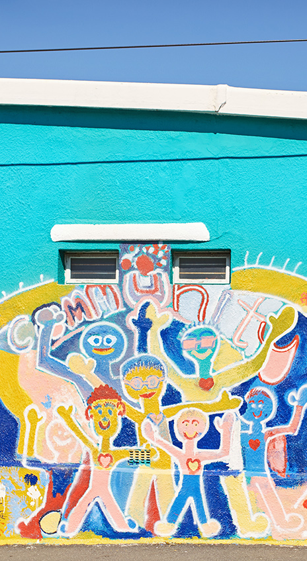
Prevention-Prepared Communities
A collaborative effort across multiple sectors including human services, education, justice, mental health, and legislative branches of government.
Notes:
Agencies target common risk factors; Cross-agency/program collaboration; and Guided by community context & citizen scientists
Agencies would coordinate efforts and technical assistance such that communities and the young people in them are continuously surrounded by protective factors rather than protected only in a single setting or at a single age
Implement a comprehensive array of programs to reduce the multiple risk factors associated with the onset and progression of substance use and associated mental, emotional, and behavioral problems among those most at-risk.

Slide 23

Thank You

