Slide 1


Nurse
Family Partnership: Improving the Life-Chances of Mothers and Children
David Olds, PhD
Professor of Pediatrics, Nursing, and Public Health
University of Colorado
December 2, 2015

Slide 2
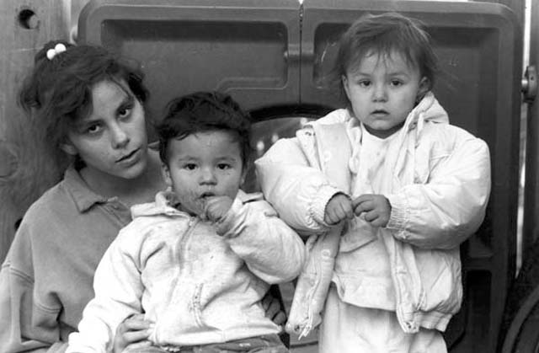
NURSE FAMILY PARTNERSHIP
Prenatal and infancy home visiting by nurses
Focused on low-income mothers with no previous live births
Clarity in goals, objectives, and methods
Activates and supports parents’ instincts to protect their children
Strengths-based

Slide 3
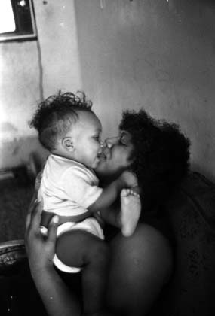
NURSE FAMILY PARTNERSHIP’S
THREE GOALS
Improve pregnancy outcomes
Improve child health and development
Improve parents’ health and economic self-sufficiency

Slide 4



TRIALS OF PROGRAM
Elmira, NY
1977
Memphis, TN
1987
Denver, CO
1994
N = 400
N = 1,138 and N=743
N = 735
Low-income whites
Semi-rural
Low-income
blacks
Urban
Large portion of Latino families
Nurse versus paraprofessional visitors

Slide 5
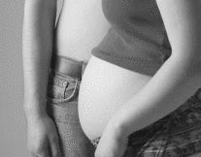

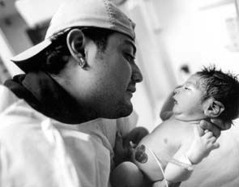
CONSISTENT RESULTS ACROSS TRIALS
Prenatal health
Children’s injuries
Children’s language and school readiness (low resource mothers)
Children’s behavioral problems
Children’s depression/anxiety
Children’s substance use
Maternal Impairment due to substance use
Short inter-birth intervals
Welfare & food stamp use

Slide 6

Indicated Cases of Child Abuse and Neglect
0 to 15 Years - Elmira
*P= .03 JAMA, 1997;278:637-643

Slide 7
Maltreatment Reports Involving the Study Child by Treatment Status and Domestic Violence
Simultaneous Region of Treatment Differences
(p < .05)
JAMA, 2000; 284: 1385-1391

Slide 8
Number of Arrests by Age and Gender
Elmira – Age 19

Slide 9
Memphis Trial:
Mental Processing Composite (Age 6)

Slide 10

Reading & Math Achievement – Age 12
(Born to Low-Resource Mothers)
p=.009, Effect Size = 0.25 Arch Pediatr Adoles Med, 164(5) 412-418

Slide 11

Percent of Children Who Used Tobacco, Alcohol, or Marijuana (Last 30 Days)
Memphis – Child Age 12
P = .04 OR = 0.31
Arch Pediatr Adoles Med, 164(5) 412-418

Slide 12

Percent of Children with Depression- Anxiety – Child Age 12
P = .04 OR = 0.63
Arch Pediatr Adoles Med, 164(5) 412-418

Slide 13
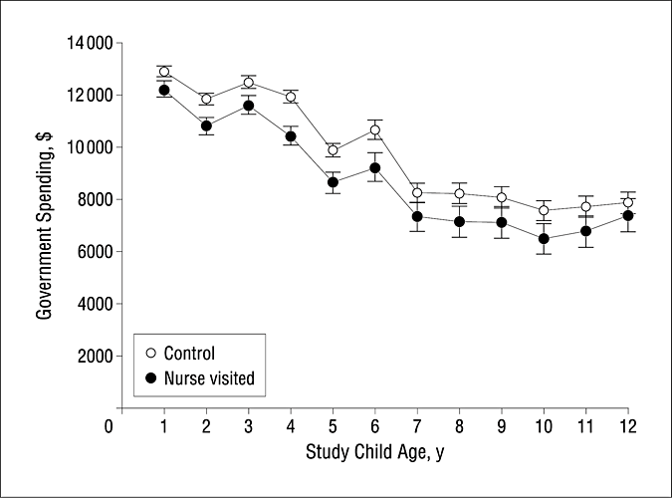

control groups over time
Total Discounted Government Spending (2006 US dollars) after Birth of First Child for Food Stamps, Medicaid, & AFDC/TANF
Copyright restrictions may apply.

Slide 14
Survival plots for intervention and control children - preventable causes of death*
* Sudden Infant Death Syndrome, injury, homicide (T2 vs. T4 p=.02) JAMAPEDIATRICS.2014.472.pages E1-E7.July 7, 2014

Slide 15
Pattern of Denver Program Effects
Maternal
and
Child
Functioning
Comparison
Para
Nurse

Slide 16

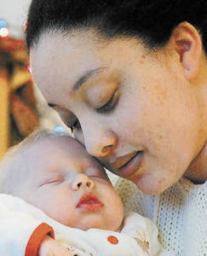
FROM SCIENCE TO PRACTICE
Support Organizational and Community Capacity
Education and Consultation
Program Guidelines
Information System
Assessing Program Performance
Continuous Improvement

Slide 17
Research Focused on Improving Program Model and Implementation
Participant retention and completed home visits
Intimate partner violence
New method to observe & promote caregiver-child interaction – DANCE and DANCE STEPS
Maternal depression and anxiety
Development of STAR (Strength and Risk) framework to guide program implementation
IT solution to improve efficiency and effectiveness
Improve NFP child welfare collaboration
Pediatrics 2013; 132; S110

Slide 18


