Slide 1
Preventing Youth Violence: Opportunities for Action
Thomas R. Simon, PhD
Division of Violence Prevention
National Center for Injury Prevention and Control
Centers for Disease Control and Prevention
The findings and conclusions of this presentation have not been formally disseminated by the Centers for Disease Control and Prevention and should not be construed to represent any agency determination or policy.
Notes:
1
1
1
1
1
I want to thank the National Prevention Science Coalition for hosting this briefing.
I really appreciate this chance to talk about youth violence.
I am going to talk today about why prevention is not only possible but strategic.
1

Slide 2
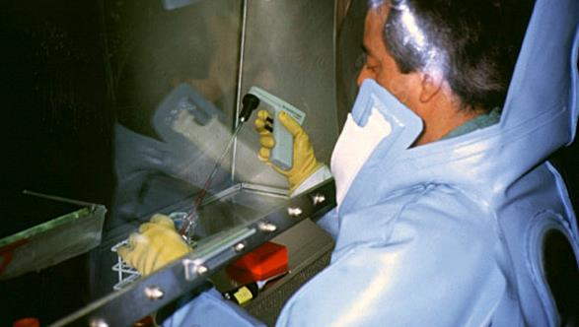
What My Family Thinks I Do…
Notes:
When I started at the CDC this is the image my family had of what I did.
I think this is true for many people – they hear CDC and they think scientists in biohazard suits working with samples.
People are often not aware that violence is also a significant public health problem or that violence prevention is part of CDC’s mission.

Slide 3
Enormous Human Costs
Homicide
4,481
Cancer
1,944
Homicide is the 3rd leading cause of death among 10-24 year olds
Responsible for more deaths than the next 7 leading causes…combined
Heart
Disease
1,041
Birth
Defects
523
Flu & Pneumonia
258
Respiratory Disease
235
Diabetes
213
Stroke
192
Source: Web-based Injury Statistics Query and Reporting System (WISQARS)
Notes:
People are often shocked to learn that homicide is the 3rd leading cause of death among adolescents and young people in our country.
In fact, when we look at the top 10 causes of death in this age group we see that more young people die from homicide than from the next 7 leading causes of death – combined.
Although violence affects all youth, we know that risk is higher among low income, urban, minority youth.

Slide 4
Every Day in the U.S…
More than 12 young people are killed
and 1,500 young people are treated in ED’s for injuries from assaults
Notes:
Every day in the U.S. an average of 12 young people are killed.
Homicides are just the tip of the iceberg.
More than 1,500 youth are treated in EDs for injuries resulting from violence.
We also know that youth who have been victims of violence are at greater risk for future violence, including later victimization and perpetration.

Slide 5
Other Destructive Health Consequences
HIV/AIDS
Head Injury
Stroke
Cancer
Injury
Chronic
Disease
Fractures
Internal Injury
Heart
Disease
Chronic Lung
Disease
Burns
Diabetes
Obesity
Depression and Anxiety
Violence
Alcohol
PTSD
Physical
Inactivity
Mental Health
Problems
Smoking
Suicide
Assault
Alcohol
And Drugs
Fetal
Death
Unsafe
Sexual Practices
STDs
Unintended
and Adolescent
Pregnancy
Multiple Partners
Pregnancy
Complications
HIV
Risk Behaviors
and Infectious Disease
Reproductive
Health Problems
Notes:
When people think of the health consequences of violence they often think of the injuries or maybe the mental health consequences but they don’t often think about the potential consequences for reproductive health, or changes in risk that are associated with infectious diseases or life-long chronic diseases.

Slide 6
Enormous Financial Costs
Youth violence costs the U.S. more than
$17 billion
in medical and work loss each year... …enough to send more than 270,000 young people through college
Notes:
There’s also a high economic cost to youth violence – the costs from just medical care and lost work due to youth violence is over $17 billion. Just to put this in perspective - This is enough money to put more that a quarter million young people through college. And this does not include all the costs associated with arrests, prosecution, incarceration or the psychological and social costs.

Slide 7
Why We Need to Act Now
Our youth are getting hurt and dying
Impacts go far beyond injuries
Youth violence hurts everyone – youth, families, businesses, etc.
Notes:
I’m emphasizing the range of consequences from violence to underscore how important it is to take action.
The number of youth getting hurt and dying is unacceptable.
The consequences of violence go far beyond injuries. Educational success, for example is related to violence. We know that 7% of higher school students report missing school at least day of school in the past 30 days because they do not feel safe.
Youth violence hurts everyone. Not just youth and their families but also businesses and entire communities.

Slide 8
Jason
Struggling families
Violence and bullying in schools
High crime and violence rates
Exposure to violent peers
Notes:
Multiple factors contribute to the risk for violence and provide opportunities for prevention.
Consider the case of Jason. He is a 12 year old boy whose mother works two jobs to support him and his older brother.
Because of bullying at school and the high crime rate in their neighborhood, Jason’s brother has taught him to strike first to avoid being robbed or harassed. Jason and his friends have a reputation for being tough, and classmates are scared of them.
But, even though Jason acts tough, he often feels afraid and doesn’t know how to deal with his fear. After witnessing the shooting of a neighbor, he has nightmares and stomachaches that keep him awake at night. In school he feels restless and has trouble concentrating.
Jason’s school tries to meet the needs of its students but often struggles and is overwhelmed.
Jason’s story illustrates how family, school, and community factors can interact to contribute to risk.

Slide 9
Violence is Also a Public Health Problem
Public Health
Prevention
Response
Criminal Justice/Service System
Notes:
Jason’s story is just one example of how violence can affect a young person’s life.
The work of public health agencies can help to make sure Jason and other youth don’t have to experience violence in their daily lives. We know that youth violence is a public health as well a criminal justice issue.
We are increasingly hearing law enforcement and community leaders say that we can’t arrest our way out of this problem! We need prevention. We need public health.
CDC’s public health approach focuses on stopping violence before it happens.
The goal is to stem the flow of children entering the juvenile justice system and reduce injuries treated in emergency departments.
We use data and research to understand the risk and protective factors and to evaluate prevention strategies to make sure that they actually work.

Slide 10
We Have Sufficient Evidence To Take Action Now
Notes:
Based on evidence from research and practice from the past 3 decades we have strategies that communities can implement now.

Slide 11
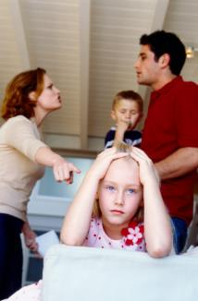
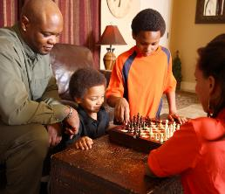
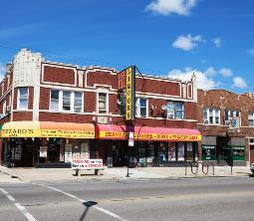
Opportunities for Action
Family
School
Community
Notes:
As Jason’s story illustrates, there are a range of opportunities for prevention.
Consistent with the social ecological model that Kristin described, we can work at multiple levels, including with families, in schools, and in communities.
I am going to share examples at each level.

Slide 12
Opportunities for Action
Examples
Child Parent Centers
Comprehensive support services for young children
Includes, structured education for children, home visits, connections to employment and mental health services
Notes:
First, I’ll mention Early family-focused prevention strategies.
One example is Child Parent Centers.
These publicly funded centers provide Comprehensive education and support services for low income children ages 3-9.
CPC’s provide structured preschool and kindergarten classes, home visits, health screening for children, as well as connections to employment and mental health services for parents. The centers include parent participation in a range of activities.
These services help connect children and their families to school and are designed to enhance healthy development and educational success.

Slide 13
Opportunities for Action
Examples
Child Parent Centers
Comprehensive support services for children ages 3-9
Includes, structured education for children, home visits, connections to employment and mental health services
22% reduction in arrests for violent crime by age 24
Reduces child abuse and neglect, youth substance use
Approximately $4-$11 saved per dollar spent
Notes:
The benefits can be remarkable. Long-term research on centers in Chicago found youth participants had a significant reduction in arrests for violent crime by age 24
The Centers have shown reductions in child abuse and neglect and youth substance use and improvements in educational progress.
A long-term cost-benefit analysis from Chicago suggest that between $4 and $11 are saved per dollar spent.

Slide 14
Opportunities for Action
Examples
Strengthening Families 10-14
Sessions for youth, parents, and entire family
Enhances communication and parents’ abilities to manage emotions and conflict
Enhances youths’ problem-solving skills
Notes:
Another example of a program for families is called “Strengthening Families 10-14”
This program includes separate and joint sessions for children and parents. It provides time for the parents and the children to practice the skills they are learning and work on resolving conflicts and improving communication.
It also includes content that is specific to children and parents. For example children are taught problem-solving skills and skills for dealing with peer pressure. Parents are taught strategies for managing their own emotions especially when disciplining their children.

Slide 15
Opportunities for Action
Examples
Strengthening Families 10-14
Sessions for youth, parents, and entire family
Enhances communication and parents’ abilities to manage emotions and conflict
Enhances youths’ problem-solving skills
Reduces fighting (32%) and destructive behavior four years after participation
Saves $3.59 for each dollar spent
Notes:
An evaluation found that students who had the program in 6th grade had a 32% relative reduction in fighting in 10th grade compared to those who did not and a 77% reduction damaging property. The program has also shown benefits on youth alcohol and drug use.
Recent cost-benefit analyses found a savings of about $3 and a half dollars for each dollar spent.

Slide 16
Opportunities for Action Examples
Life Skills Training (LST)
Classroom program for middle school students
Teaches decision-making skills, managing stress and anxiety, developing healthy relationships, resisting negative influences
Notes:
The field has also developed a range of school-based programs. These are often designed to change how youth think and feel about violence and to help them develop youths skills to resolve disputes without violence. A systematic review of these program found consistent positive benefits regardless of grade level, race/ethnicity, or socioeconomic status.
One example is the Life Skills Training program of LST
LST consists of 30 classroom sessions in the first year with booster sessions for the next two years. The program teaches a range of decision-making, self-management, and social skills. The primary focus is on substance use prevention but the skills apply to violence and other health issues.

Slide 17
Opportunities for Action Examples
Life Skills Training (LST)
Classroom program for middle school students
Teaches decision-making skills, managing stress and anxiety, developing healthy relationships, resisting negative influences
Reduced delinquency (32%) and fighting (26%)
Lowered tobacco, alcohol and drug use, risky sexual behaviors
Saves $13.08 for each dollar spent
Notes:
Several evaluations of LST have been conducted and they show reductions in delinquency and frequent fighting in the past year.
They also show benefits on a range of behaviors, including lower tobacco, alcohol and other drug use, as well as lower levels of risky sexual behaviors, and even risky driving.
Cost benefit analyses estimate a savings of approximately $13 for each dollar spent.

Slide 18
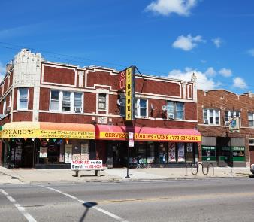
Opportunities for Action Examples
Cardiff Model
Sharing of emergency department and law enforcement data
Prevention partnership recommends strategies
Targeted policing, modifying public transportation schedules, securing building materials
Notes:
Community level change strategies like are also promising because of increasing evidence of their ability to reduce violence and increase positive interactions in entire neighborhoods.
One example of a community intervention is the Cardiff Model. The model was started by Dr. Jon Shepherd ED surgeon in Cardiff, Wales sickened by the violence related injuries he was seeing.
He knew most of the cases were not reported to law enforcement so he developed a model that allowed for anonymous emergency department data to be shared with law enforcement on a regular basis.
Admission staff collect very basic information about the incident, such as the location of the violent event and day/time of the event. Every 4-6 weeks, the data are stripped of identifiers and combined with police data and a summary report with a hotspot map is prepared and shared with a partnership group [including representatives from city government, police, city licensing regulators, and the ED. This summary allows for tracking of violence incidents and informs group decisions about prevention activities and policies.]
In the city of Cardiff UK, partners used the data to refine the locations and timing of policing but also to implement a range of novel prevention strategies.

Slide 19
Opportunities for Action Examples
Cardiff Model
Sharing of emergency department and law enforcement data
Prevention partnership recommends strategies
Targeted policing, modifying public transportation schedules, securing building materials
32% reduction in assaults; 42% reduction in hospital admissions
Estimated savings of $19 in criminal justice costs for each dollar spent
Notes:
CDC staff collaborated with Dr. Shepard to evaluate the data sharing model and found significant and lasting reductions in assaults and hospital admissions.
We also found significant savings relative to costs (estimated $19 in criminal justice system costs saved for each dollar spent, including enforcement, court, and probation).
The Cardiff Violence Prevention model is currently applied in over 130 hospitals in England and Wales and is being piloted in Scotland, Amsterdam, and South Africa.
It is also relevant in the U.S. Department of Justice data indicate that over half of violent assaults in the U.S. are not reported to law enforcement. This represents a potentially critical information gap that could result in missed opportunities for prevention and disparities in the response to violence within communities if subpopulations are reluctant to report to police. The CDC is currently collaborating with RWJF and the University of PA to replicate this model in the U.S.

Slide 20
Opportunities for Action
Evidence from research
Lasting benefits
Extend across violence and other health risks
Cost-savings
Available now
Family
School
Community
Notes:
These are just a few strategies that can be used with families and in schools and communities to reduce youth violence.
I share these to provide some concrete examples that demonstrate that there is evidence that prevention strategies can have lasting benefits on risk for violence.
Because the strategies address common underlying risk factors they often have positive benefits on other health outcomes.
We also increasingly have estimates from cost-benefit analyses that we can draw on and they help us to understand the potential savings by focusing on prevention.
The main point is that we have strategies that work quite well and action is possible now.

Slide 21
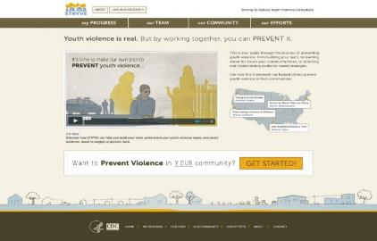
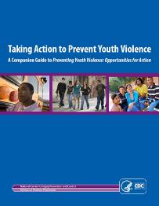
STRYVE Strategy Selector Tool Striving To Reduce Youth Violence Everywhere http://vetoviolence.cdc.gov/apps/stryve
Prevention Resources
Preventing Youth Violence: Opportunities for Action
Notes:
That said, there is a gap between what is known about what works and what is happening in many communities.
To help communities bridge this gap the CDC has released Preventing Youth Violence: Opportunities for Action and a companion document, Taking Action to Prevent Youth Violence.
These resources make what is known about preventing youth violence more accessible to communities.
They are designed to raise awareness about the problem of youth violence and the opportunities we have to prevent it.
One of the tools that we highlight in these documents is CDC’s Striving to Reduce Youth Violence Everywhere (or STRYVE) Strategies Selector Tool.
As part of the many STRYVE Online resources, this new tool will help communities connect their unique risks and needs to specific prevention activities based on the best available evidence.
Under CDC’s STRYVE initiative we are providing resources to local health departments so they can help communities select and implement prevention strategies.

Slide 22
Violence Prevention is Strategic
Notes:
I just want to end by underscoring the point that not only is violence prevention the ethical thing to do to reduce injuries, deaths, and disparities among youth - it is also strategic.

Slide 23
The Strategic Importance of Preventing Youth Violence
Big Public Health and Social Problem
Influences many different health and social outcomes
Human and Economic costs are substantial
Viable Prevention Strategies Exist
Notes:
It is strategic because violence is a major problem with a range of health and social consequences. The human and financial costs are substantial.
But our investments in research are paying off. We have learned a lot about works to stop youth violence. Prevention strategies can reduce risk for violence and other health problems and save money!
We have an opportunity and responsibility to help communities take action.

Slide 24
For More Information
Visit CDC’s National Center for
Injury Prevention and Control web site:
www.cdc.gov/injury
Notes:
Please visit our website to learn more about CDC’s data, research, programs and resources.

