Slide 1
Opioids in America: Opportunities for Prevention and Treatment
Scott P. Novak, Ph.D.
Senior Research Scientist
Congressional Briefing: Fighting the Opioid Epidemic on Multiple Fronts by Leveraging Empirical Evidence
Washington, DC
May 6, 2016

Slide 2

Who Am I?
RTI International: Non-profit research institution dedicated to improving the human condition through research and policy.
Contractor for the National Survey on Drug Use and Health (SAMHSA)
America’s Best Hospital Survey (US News and World Report
Evaluation contracts for several notable opioid-related projects
      SAMHSA’s Prescription Drug in the Workforce (Listserv on Rx related issues)
      CDC’s 60 Million Dollar Prevention for States on Prescription Opioid Overdose
      DEA’s National Forensic Laboratory and Information System
      NIH research in the genetic, neurological, psychological and social/economic factors that predict overdose, naloxone utilization, opioid treatment seeking, opioid overdose, relapse, syringe sharing and associated risk outcomes (addiction, HIV/AIDS, Hep-C)
      Pharmaceutical funding: Phase IV population studies to track opioid abusers over time to understand the onset and course of opioid symptoms and use of opioid replacement products (e.g., buprenorphine oral, depo and methadone)

Slide 3
Key Discussion Points
What is the opioid crisis in the United States?
What do we “knew” scientifically?
What are the opportunities for intervention, given:
  STOPP Act: Stop Tampering of Prescription Pills
  Reducing unused medications act

Slide 4

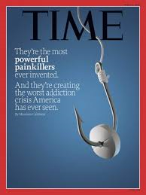

What is the Opioid Crisis: Some Quick Terms
Opium: Any substance that acts on the opioid receptors (mu, kappa) throughout body, primarily in brain and gut. Derived from the poppy plant.
Opioid: Global term but specifically synthetically man-made to work like the opium poppy.
        Methadone
        Vicodin/Lortab (hydrocodone)
        Percocet/OxyContin (oxycodone)
Opiate: Naturally occurring alkaloids derived directly from opium poppy plant.
        Prescription type (Codeine)
        Licit/Illicit (Heroin)

Slide 5

What’s the Scope of the Problem?
Continues to rise after 2010
NOTES: Drug poisoning deaths are a subset of poisoning deaths. Unintentional drug poisoning deaths are a subset of drug poisoning deaths.
SOURCE: CDC/NCHS, National Vital Statistics System; and Warner M, Chen LH, Makuc DM, Anderson RN, Miniño AM. Drug poisoning deaths in the United States, 1980–2008. NCHS data brief, no 81. Hyattsville, MD: National Center for Health Statistics. 2011. http://www.cdc.gov/nchs/data/databriefs/db81.htm. Intercensal populations http://www.cdc.gov/nchs/nvss/bridged_race/data_documentation.htm

Slide 6
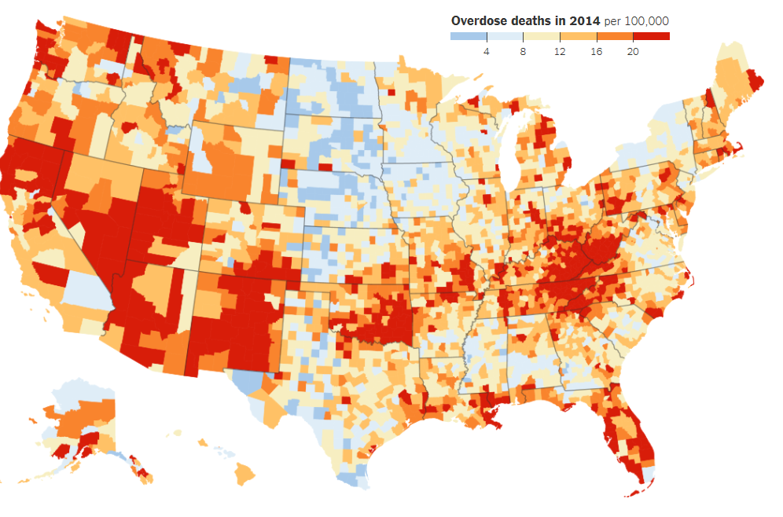
Overdose is Everywhere!
Source: CDC Wonder System (2016)

Slide 7
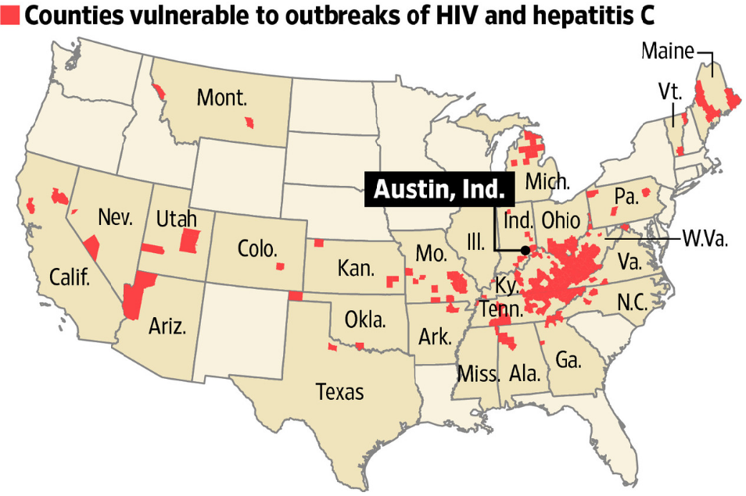
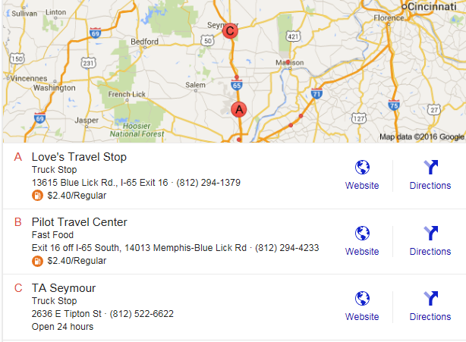
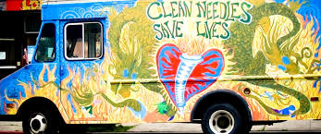
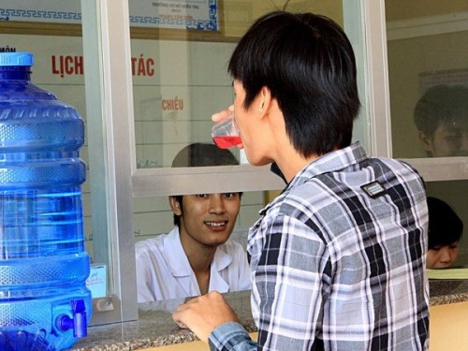
The Crisis is Not Just Overdoses:
In 2015, 199 HIV cases linked to Opana injecting in Scott County, IN
Lack of needle exchange programs and methadone/drug treatment programs in area
High risk behaviors: truck stops

Slide 8
Opioid Prescribing Seems Like the Culprit, but Wait…
Rx Opioid prescribing is going down while crisis continues to rise!
2016: Cigna announces a 25% reduction in opioid prescribing
CDC releases new prescriber guidelines

Slide 9
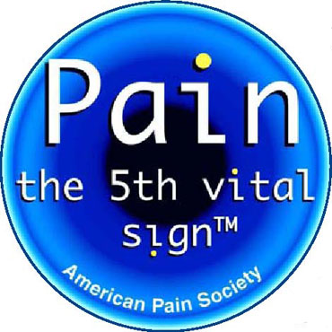
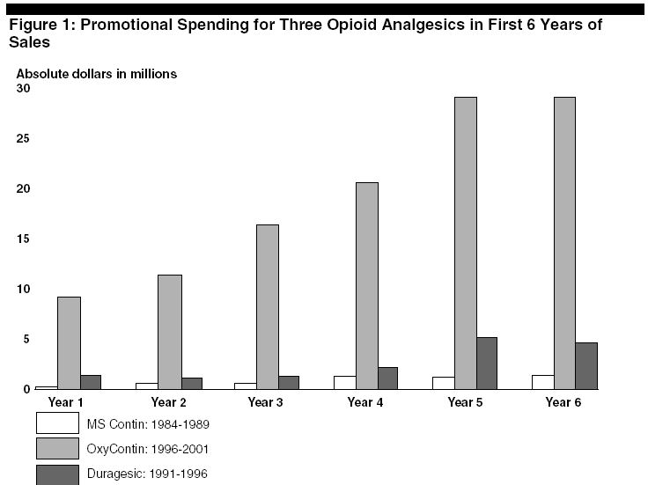
What Else Could Have Sparked the Crisis?
In 1995, Purdue Pharma Introduced OxyContin™
First Long Acting Oxycodone product
  Required less pills than immediate release formulation
  Marketing campaign argued that less pills=less addiction
Pain is the 5th Vital Sign—increased diagnoses and treatment of pain with opioids in 2000s and beyond

Slide 10
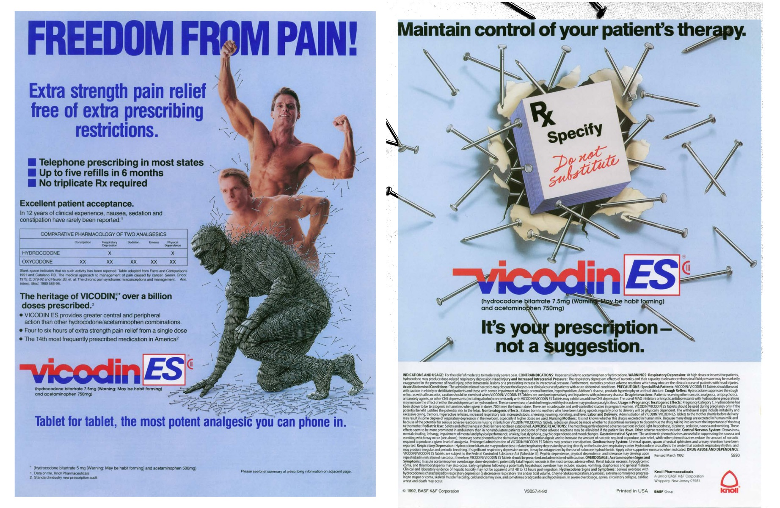
Belief that opioids are 100% cure for chronic pain

Slide 11
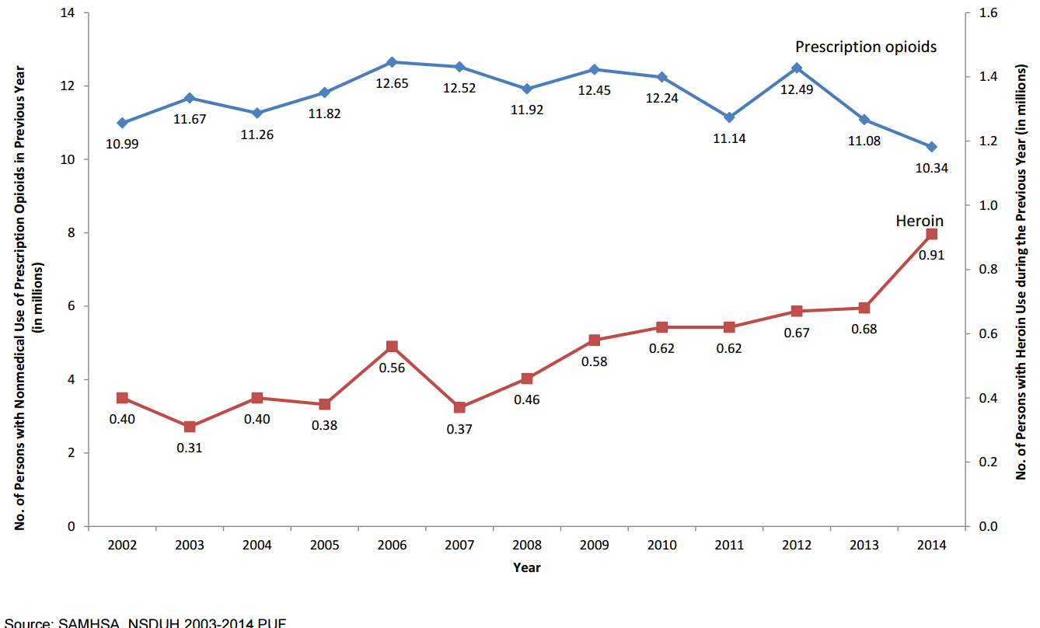
Prescription Pain Reliever Misuse and Heroin Use

Slide 12
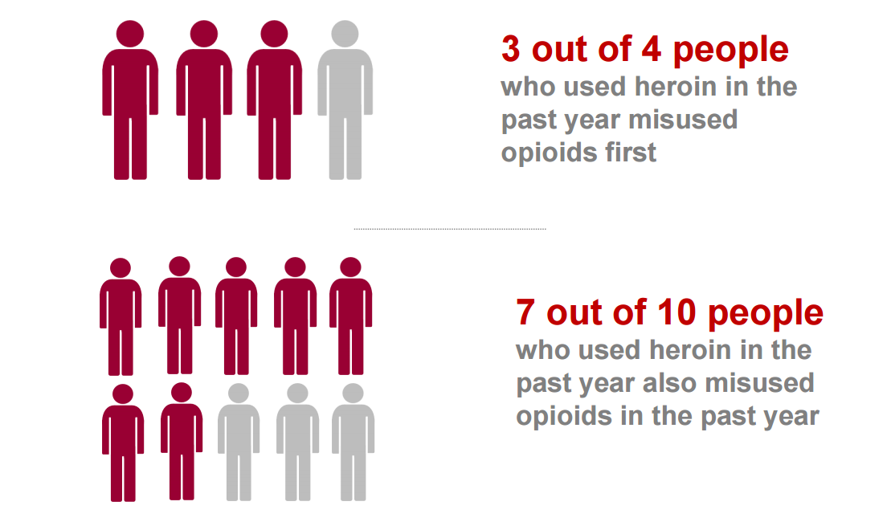
Nonmedical use of Rx opioids is a risk for heroin

Slide 13
The Changing Demographics of Heroin Use
 | 2002-2004 | 2011-2013 | % Change
SEX Male Female | 2.4 0.8 | 3.6 1.6 | 50% 100%
AGE 12-17 18-25 26 or older | 1.8 3.5 1.2 | 1.6 7.3 1.9 | -- 109% 58%
RACE White Other | 1.4 2.0 | 3.0 1.7 | 114% --
INSURANCE None Medicaid Private or other | 3.4 1.3 1.0 | 5.5 2.3 1.6 | 62% 77% 60%
INCOME <$20,000 $20,000-$49,999 $50,000 or more | 4.2 4.3 0.8 | 6.7 4.7 1.3 | 60% -- 63%
More women
More older youth
More white
More Medicaid
More wealth!
Source: Cicero et al JAMA Psychiatry 2014

Slide 14
Heroin Users and Rx Opioid Abuses are Poly Drug Users
28% 2 substances other than Rx Opioids and Heroin in past year
Source: 2014 NSDUH

Slide 15
Abuse Deterrent Opioids May be the Key
Different routes of administration associated with elevated health risks
  Overdose
  Addiction
  HIV/Hep-C (needle sharing)
  Other long-term hepatic functioning and neurological disorders
Oral is the most common route among Lifetime NMPOUs \
  80% use oral
  Snort (10%)
  Smoke (7%)
  Inject (3%)
  Rectal (%0.5)
Abuse Deterrent Formulations
  First introduced in 2010 with reformulated OxyContin
  Currently about 20% of opioids are ADFs
  Barriers, Chemical Matrix, or Aversion

Slide 16
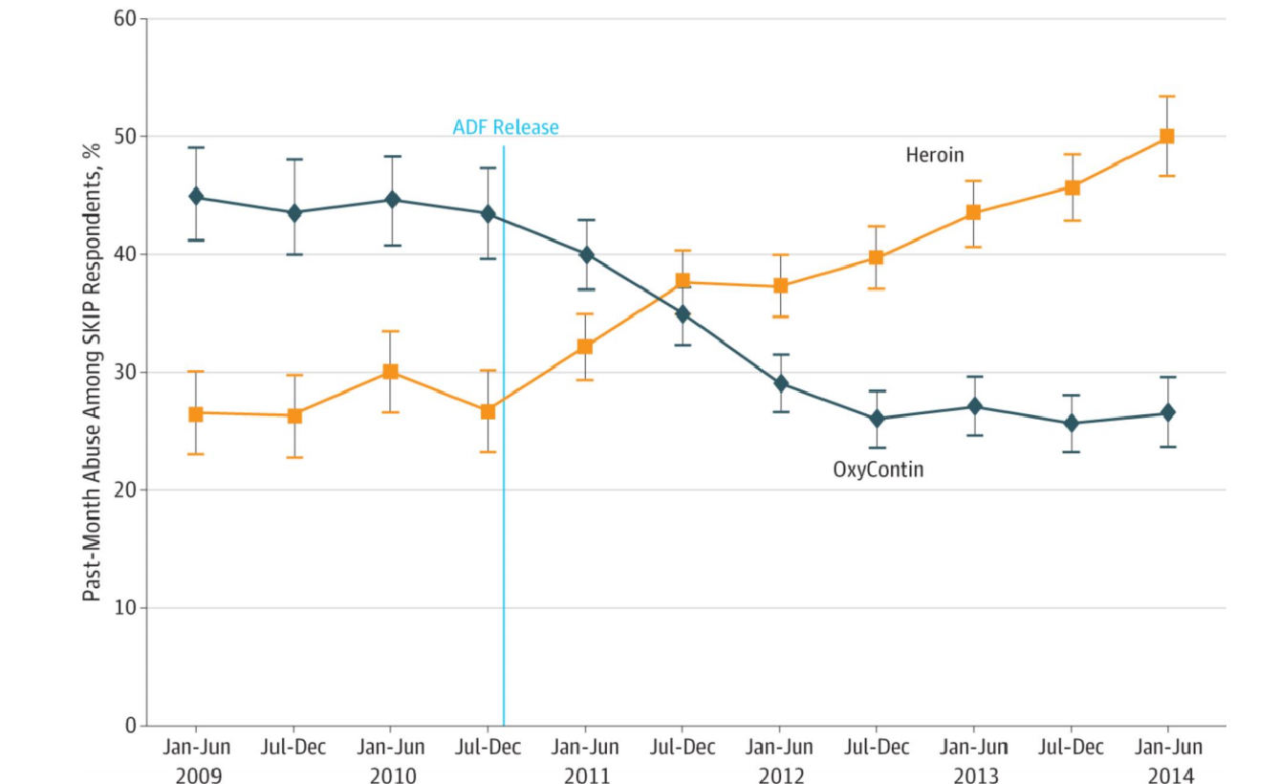
The Reforumulation of OxyContin Causes Shifts in Abuse

Slide 17
Some Major Policy Considerations
Supply Side Programs:
  Prescription Drug Monitoring Programs (active in 49 states)
  DEA take-back programs
  Rescheduling of hydrocodone from S3 to S2
  Prescriber Guidelines (CDC, Cigna) from federal and commercial insurers
  FDA: Risk Evaluation and Mitigation Strategies
  FDA: Support medication development with ADF properties
Federal Interventions:
  Prescription Drug Overdose for States (CDC, $60 million)
  Prescription Drug (SAMHSA, $100 million)
  Prescription Drug Abuse in Workforce ($2-3 million)
  Surveillance Systems for drug abuse (NSDUH/SAMHSA and NSFLIS/DEA)
  Drug Treatment Programs for compassionate care and raise limits for opioid replacement therapy

Slide 18
What Next:
Four focus areas:
1) Improve systems to track prescriptions and identify misuse
2) Identify prevention policies and programs that work
3) Increase health care provider accountability
4) Educate health care providers, policy makers, and the public

Slide 19
The Risk of Reduced Access?
Should we keep trying to chase a pain score of “0”? What are the unintended consequences of reducing access?
80% of extra-medial opioid use obtained from friend, but most of these (3 out of 4) knew the person had a legit prescription
Consider the following: I know I could go and find someone to sell me heroin in 10 minutes. Of course it’s crossed my mind because I’m in untreated pain all the time and I’m so desperate for some relief
In a recent survey (Kennedy-Hendricks, JAMA-Internal Med 2016)
  20% ever shared opioid medicines
  7% shared most recent opioid prescription
  73% of which was to help person treat pain
  48% kept for future use
  1% sold
  **Opioid sparing is not a problem

Slide 20
Summary
The opioid crisis isn’t that we have too many opioids, though that many pills floating around is a problem
The opioid crisis is directly related to abusing via tampering, involving overdoses, addiction, and HIV/Hep-C
Changes in OxyContin formulation in 1995 caused the crisis by creating false sense of security that prescription medications (ER/LA) were addiction proof; thus led to increased and risky prescribing
Changes in OxyContin in 2010 caused heroin crisis
Changes in prescribing of ADFs may help curb crisis, but we need to acknowledge that abusers have a large constellation of mental health disorders and extensive substance use history
Need to be wary of restricting access to pain medicine, as nation grows older and baby boomers hit the opioid years!

Slide 21
More Information
Name
Scott Novak, Ph.D.
919-541-7129
snovak@rti.org

