Slide 1
The Costs of Behavioral Health Problems- The Power of Family Focused Programs to Prevent Them- The Promise of Providing These Programs through Primary Health Care J. David Hawkins PhD Social Development Research Group School of Social Work University of Washington Board on Children, Youth and Families National Academies of Science, Engineering and Medicine Coalition for the Promotion of Behavioral Health

Slide 2
Parenting is the hardest, but most important, job we do.
It doesn’t come with a manual.
What would America be like if ALL parents were prepared to raise physically and behaviorally healthy children?

Slide 3
U.S. children are expelled or suspended from preschool at three times the rate of children in grades k through 12.
Black children represent 18% of preschool enrollment, but 48% of children receiving more than one out-of-school suspension.
This has been going on for more than a decade.
(Gilliam, 2005; U.S Department of Education Office for Civil Rights, 2014)

Slide 4
“In 2015, 52% of Baltimore City Public Schools’ kindergarteners entered school without sufficient social-behavioral skills needed to learn.”
(Bettencourt et al. 2016)
Notes:
Social-behavioral skills develop early, before children enter school, and are essential for learning in a classroom setting.
These are skills children need to follow directions, comply with rules, manage emotions, solve problems, organize and complete tasks, and get along with others.

Slide 5
In Baltimore…
By 4th grade, students entering kindergarten not socially and behaviorally ready for school were:
80% more likely to be held back in their grade
80% more likely to receive services and supports through an IEP or a 504 Plan
7 times more likely to be suspended or expelled at least once in elementary grades.
(Bettencourt et al., 2016)

Slide 6
An Essential Feature of Child Development
Secure and responsive relationships with adults…are foundational for the healthy development of young children.
Conversely, adults who are under-informed, underprepared, or subject to chronic stress themselves may contribute to children’s experiences of adversity and stress and undermine their development and learning.
(Allen & Kelly, IOM & NRC, 2015)
Notes:
Who are the most important adults in children’s lives? Their parents, their daily caretakers, the people who put them to bed at night.

Slide 7
Stress, the brain, biology and behavior
early psychosocial adversities …can have important short- and long-term effects on the brain’s development, the regulation of stress responsive hormone systems, and the calibration of stress reactivity at a variety of levels from behavioral to gene expression responses.
(Allen & Jones, IOM NRC, 2015)

Slide 8
Result Behavioral Health Problems
Anxiety
Depression
Alcohol, tobacco, other drug use
Risky driving
Aggressive behavior and conduct problems
Delinquent behavior
Violence
School dropout
Self-inflicted injury
Risky sexual behavior
Notes:
The more we learn about the brain, the more we understand how exposure to multiple risk factors during childhood increases risk for a variety of behavioral health problems.

Slide 9
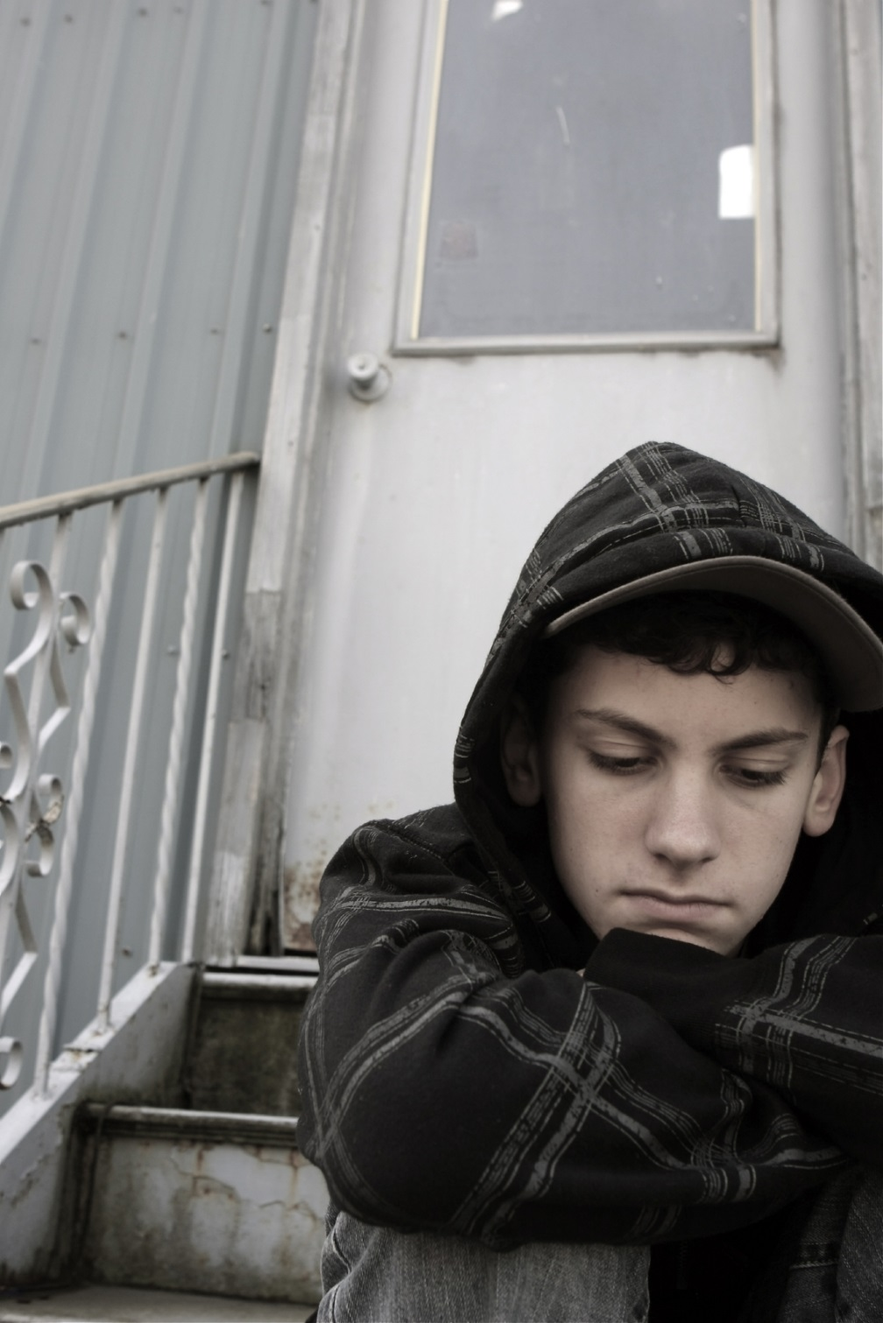
Nearly half (49.5%) of all teens 13 -18 experience one or more behavioral health problems.
Over one in five (22.2%) have severe impairment.
National Co-Morbidity Survey-Adolescent
http://www.ncbi.nlm.nih.gov/pmc/articles/PMC2946114/table/T2/

Slide 10
Total Annual costs of youth behavioral health problems
$247 billion per year
(NRC and IOM, 2009)

Slide 11
Parents are primary
How can we ensure that all parents are equipped to provide nurturing environments for their children’s healthy development.
And thereby – to prevent behavioral health problems before they result in educational failure, lost lives, and big costs.
Notes:
the first and most important influences on children’s health, cognitive, emotional, behavioral and physical development

Slide 12
Progress in Healthy Parenting
At least sixteen family focused prevention programs are tested, proven effective, and ready for use.
Universal programs for all parents,
Selective programs for parents of children exposed to elevated risks and adverse experiences,
Indicated programs for parents of children showing early signs of behavioral or mental problems.
All three types effective in improving children’s behavioral health outcomes. (Blueprints for Healthy Youth Development, 2016)

Slide 13
Blueprints for Healthy Youth Development “Model” and “Promising” Family-focused Preventive Programs
Program & Focal age | Impact
Family Foundations (0-2) | Antisocial-aggressive Behavior, Anxiety, Conduct Problems, Depression, Externalizing, Internalizing, Prosocial with Peers
Nurse-Family Partnership (0-2) | Child Maltreatment, Delinquency and Criminal Behavior, Early Cognitive Development, Internalizing, Mental Health - Other, Physical Health and Well-Being, Preschool
Family Check-up (Toddler Version; 0-2) | Conduct Problems, Externalizing, Internalizing, Reciprocal Parent-Child Warmth
Triple P System (0-11) | Child Maltreatment, Mental Health - Other
Incredible Years – Parent (3-11) | Antisocial-aggressive Behavior, Close Relationships with Parents, Conduct Problems, Depression, Externalizing, Internalizing, Positive Social/Prosocial Behavior, Truancy- School Attendance
Parent Management Training – Oregon Model (3-18) (0-2) | Antisocial-aggressive Behavior, Conduct Problems, Delinquency and Criminal Behavior, Externalizing, Internalizing
Notes:
Let’s quickly look at these programs. These are just the ones approved by Blueprints. I think Blueprints should be the UL of preventive interventions. They apply a set of evaluation quality standards that provide assurance that the model and promising programs they identify have been experimentally proven to have the effects you see under IMPACT. Note the wide variety of behavioral health outcomes that can be affected by helping parents build their capacity to build secure and responsive relationships with their children. On the left column note in parens the ages at which these programs have been proven effective starting from pregnancy through the child’s adolescence. the Incredible years parenting program is highlighted because you will hear more about that program today. From early on through childhood, it has shown important effects.

Slide 14
Blueprints for Healthy Youth Development “Model” and “Promising” Family-focused Preventive Programs
Program & Focal Age | Impact
Parent-Child Interaction Therapy (PCIT; 3-11) | Antisocial-aggressive Behavior, Child Maltreatment, Conduct Problems
New Beginnings (For children of divorce; 5-18) | Antisocial-aggressive Behavior, Close Relationships with Parents, Externalizing, Internalizing, Mental Health - Other, Reciprocal Parent-Child Warmth, Sexual Risk Behaviors
Strong African American Families Program (5-11) | Child Maltreatment, Depressive symptoms, Mental Health - Other
Strengthening Families (10-14) | Alcohol, Antisocial-aggressive Behavior, Close Relationships with Parents, Illicit Drug Use, Internalizing, Tobacco
EFFEKT (12-14) | Alcohol, Delinquency and Criminal Behavior
Notes:
Moving up to Childhood. Some programs like incredible years have shown positive effects across four different racial groups, some programs are designed for families from specific racial groups. Like the strong african american families program focused on building AA caregivers capacity for protective caregiving. This program strengthens positive parenting and youth self regulation, and there is now evidence that this program affects biological systems like low-grade inflamation and stress hormones in ways that protect against the adverse physiological effects of early exposure to disadvantage and adverse experiences.

Slide 15
Blueprints for Healthy Youth Development “Model” and “Promising” Family-focused Preventive Programs”
Program Target | Impact
Familias Unidas Preventive Intervention (12-18) | Externalizing, Illicit Drug Use, Sexual Risk Behaviors
Guiding Good Choices (12-14) | Alcohol, Delinquency and Criminal Behavior, Depression, Illicit Drug Use
Positive Family Support – Family Check-up (12-14) | Alcohol, Depression, Sexual Risk Behaviors, Tobacco
Functional Family Therapy (FFT; 12-18) | Delinquency and Criminal Behavior, Illicit Drug Use
Multisystemic Therapy – Problem Sexual Behavior (MST-PSB; 12-18) | Academic Performance, Adult Crime, Delinquency and Criminal Behavior, Illicit Drug Use, Mental Health - Other, Prosocial with Peers, Sexual Risk Behaviors, Sexual Violence
Notes:
And yes, there are programs for parents of adolescents that work! Familias Unidas is a program for spanish speaking families of teens that you will hear more about today. Note the broad effects. The last two programs here are indicated prevention programs for youth at risk of out of home or institutional placement due to caretaker or youth behaviors. Again note the wide ranging effects produced when programs provide skills and tools for positive parenting even in adolescence.

Slide 16
Healthy Parenting A Good Investment
Eight of 10 parenting programs studied by WSIPP produced positive benefit to cost ratio.
Examples:
Incredible Years Parenting: Benefit to cost ratio $1.89
Benefits minus costs = $1154 per participant
Strengthening Families 10-14: benefit to cost ratio $3.78
Benefits minus costs = $3104 per participant
(Washington State Institute for Public Policy, 2015)

Slide 17
Fewer than 18% of eligible parents participate in parenting programs offered in community settings outside of the health care system. (Rulison et al. 2015)
HOWEVER

Slide 18
Why are effective parenting programs not widely attended?
Social norms and perceptions limit participation.
Legitimacy of sponsoring organizations to offer parenting advice is not clear.

Slide 19
NEEDED
A trusted and legitimate professional home for family focused prevention programs…
Primary health care!?

Slide 20
Opportunities for family focused prevention through primary care
ACA, CHIP, and Medicaid expansion focus on prevention and population health and increase access to health care for all families.
Bright Futures Guidelines provide opportunities for screening children and interaction with parents in primary care.
Medical Homes create family-centered partnerships between primary care providers and families for preventive services and treatment.

Slide 21
Advantages to Providing Parenting Programs in Primary Care
Primary care is accessible, universal and relatively affordable with current health insurance coverage.
Pediatricians and family physicians have high credibility and are trusted by parents. Can validate and reinforce good parenting practices.
Services provided in a primary care setting are non-stigmatizing. Everyone with a child goes to primary care, not just those with problems.

Slide 22
Advantages to Providing Parenting Programs in Primary Care
One of the best ways to help children is to help their parents; the well-being of both parents and children can be addressed in primary care.
A child can be a motivating factor for parents to change behaviors, such as smoking, that affect both their own health and the health of their child.
These advantages may create high recruitment and retention rates for family-focused prevention programs.

Slide 23
What if 40% or more of eligible families could be reached with effective preventive interventions for behavioral health problems through primary health care?

Slide 24
Evidence Is Growing:
Supporting healthy parenting in primary care is feasible and effective.
(National Institute for Children’s Health Quality, Ariadne Labs, Einhorn Family Charitable Trust, 2016)

Slide 25
An Achievable Vision for the Nation
Pediatric and family practice providers prescribe preventive interventions from a tiered menu of proven family focused prevention resources.
Participating in proven family focused prevention programs through primary care is a shared parental expectation for promoting children’s physical and behavioral health.

