Slide 1
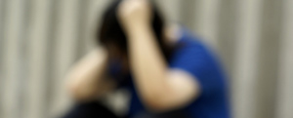
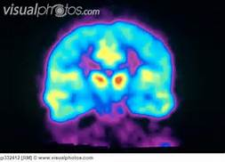
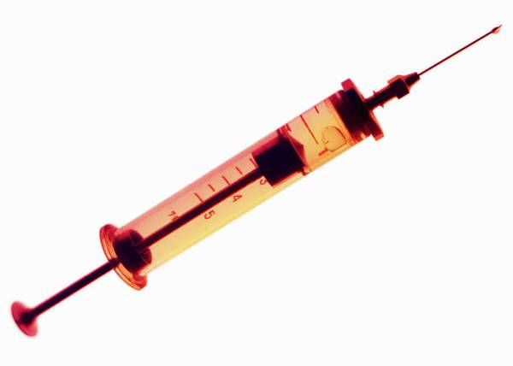
The Real Dangers
of Equating
Opioid
Dependence
with Addiction
Nora D. Volkow, M.D.
Director
National Institute on Drug Abuse
National Institutes of Health
@NIDAnews
Notes:
The Real Dangers of Equating Opioid Dependence with Addiction
You are asked to speak for a maximum of 15 minutes and cover the following:
The distinction between dependence and addiction
How this distinction manifests at the behavioral and biological (brain) level
Its implications for preventing and treating OUD and pain conditions
Data demonstrating that most overdoses occur in people misusing opioids-not taking them as medically prescribed (Emily is checking into the data on this)
Research needs in this space

Slide 2
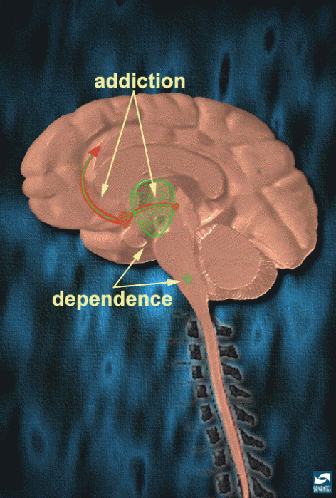
Develops slowly (months)
in 10-20% exposed
Reward, mood, executive function circuits
Intense craving, compulsive use, unable to stop
Persists for months or years
Develops rapidly (days)
in most people
Autonomic regions
Withdrawal symptoms
Resolves within days
Physical
NIDA. (2007, January 2). The Neurobiology of Drug Addiction. Retrieved from https://www.drugabuse.gov/neurobiology-drug-addiction on 2019, November 12

Slide 3
Physical Dependence
Develops rapidly (days)
in most people
Represents cellular adaptations in autonomic regions
Manifests as physical withdrawal symptoms
Resolves within days
Treated by slowly tapering the drug
Christie Br J Pharmacol. 2008
Graphic from: Safe Harbor Recovery

Slide 4
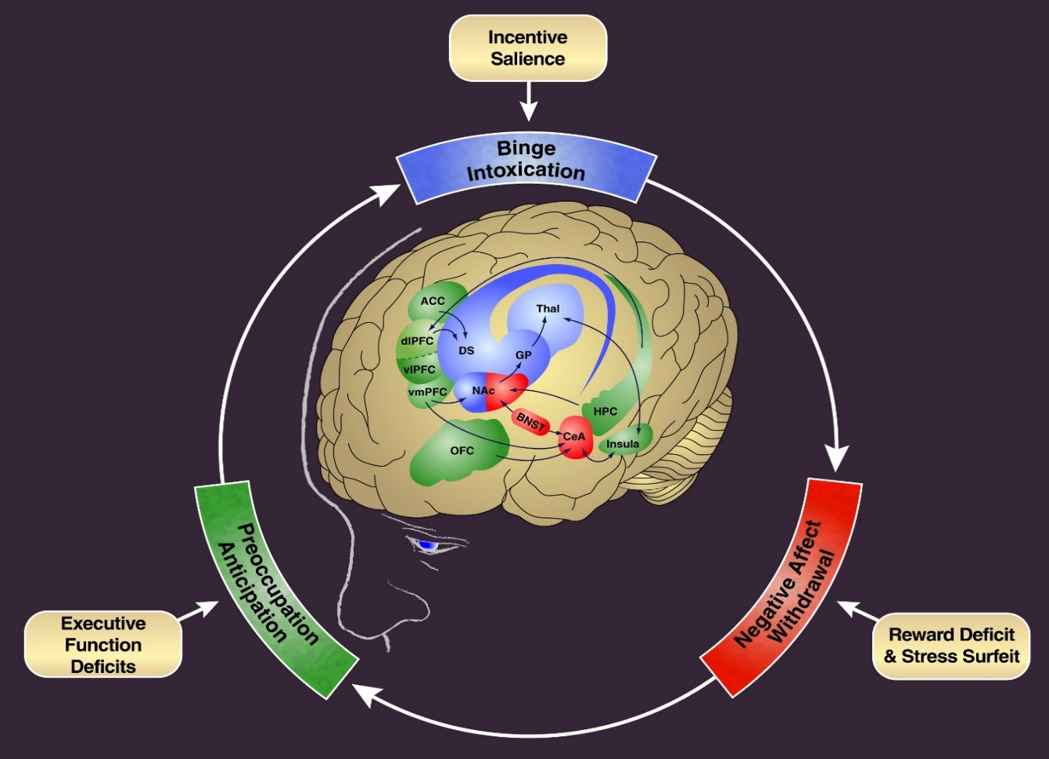
Addiction
Develops slowly (months)
in those vulnerable (10-20%)
Long-lasting adaptation in brain circuits involved with reward, self regulation and mood
Manifest as intense drug craving, compulsive use and inability to stop despite harm
Takes months or years to resolve
Treated long term with medications along with behavioral support therapies
Koob, GF and Volkow ND, Neuropsychopharmacology Reviews 2010

Slide 5
Committee on Medication-Assisted
Treatment for Opioid Use Disorder
Consensus Study
Released: March 20, 2019
Credit: Stateline, an initiative of The Pew Charitable Trusts
https://www.pewtrusts.org/en/research-and-analysis/blogs/stateline

Slide 6
Physical dependence is treated by slowly tapering off the opioid drug and resolves within days. Most people treated with opioids for pain have physical dependence but are not addicted.
Addiction benefits from medications (MOUD or MAT) and requires chronic treatment (months or years). Most individuals with addiction will also have physical dependence.
Clinicians need to be trained to differentiate physical dependence from addiction.

Slide 8
There are millions of patients in the US who rely on opioids for pain management and, over the years, have become dependent on them…
but most are not addicted…
Proper screening, appropriate prescribing and careful monitoring can prevent the escalation
from dependence to addiction…
©iStock/PeopleImages

Slide 9
Chronic Heroin Desensitizes μ Opioid Receptor-Activated G-Proteins in Brainstem Autonomic Nuclei Implicated in Physical Dependence
Autonomic Nuclei
Heroin exposed rats have decreases in μ opioid-stimulated [³⁵S]GTPγS in locus coeruleus (A), periaqueductal gray (B), and thalamus/amygdala (C), but not caudate putamen/nucleus accumbens/cingulate cortex (D).
Ratios of DAMGO-stimulated [³⁵S]GTPγS to mu receptor binding (G/R ratios) in heroin exposed. Greatest reductions: periaqueductal gray; interpeduncular nucleus; lateral parabrachial; locus coeruleus; nucleus tractus solitarius.
Sim-Selley et al., J Neurosci. 2000

Slide 10
Williams et al., Pharmacol Rev. 2013
Christie Br J Pharmacol. 2008
Safe Harbor Recovery

