Slide 1
THE SOCIAL ECOLOGY OF YOUTH VIOLENCE: Implications for Evidence-Based Community Crime Prevention A presentation to the House Youth Violence Congressional Briefing
Dr. Peter Scharf
Dr. Stephen Phillippi

Slide 2
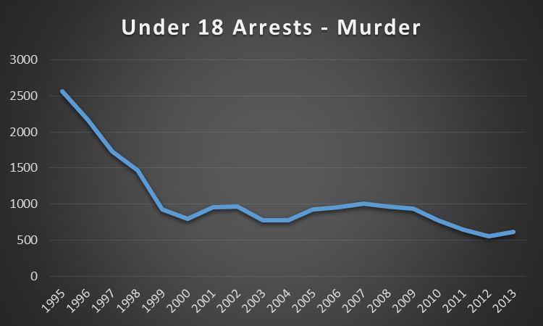
What Contributes To Youth Violence Rates?
Understanding
Why
Crime
Fell
in
the
1990s:
Four
Factors
that
Explain
the
Limited Impact
Outdated and narrow policing strategies
Increasing prison populations
Non-evidenced based programs
Substantial Impact
Risk Cohort
Drug use patterns
Demographics
Six
Not
Decline
and
that
Do
St
Notes:
Are we better than the Barbershop guys from Leavitt and Dubner: Freakanomics:

Slide 3
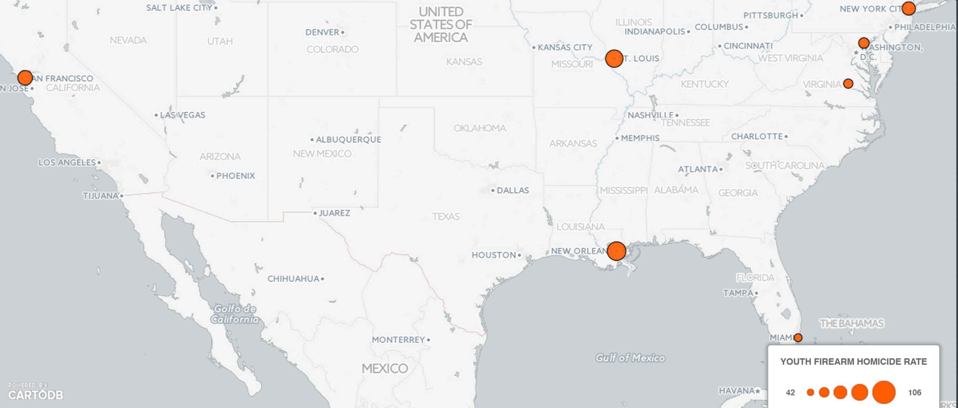
Necessary Questions Concerning Youth Violence
Have reductions in youth violence stabilized?
How will decreases in federal funding for juvenile justice prevention programs affect future violence rates?
Given that youth violence is a geographically concentrated phenomenon, what solutions are effective and realistic?
Notes:
Reductions in violence over the past twenty years may have reversed. Also, there has been public debate regarding

Slide 4
Youth Violence In New Orleans
New Orleans saw a 35% increase in murders between June 2014 and June 2015
Extreme racial and economic inequalities in criminal youth justice involvement
Disproportionate minority school expulsions, suspensions, and arrests
Notes:
City-wide murder rate approximately 10 times the national average
Lack of diversion from formal justice processing for minority youth

Slide 5
Innovative Frameworks
Social Ecological and Public Health Perspectives
Lifecycle Trauma
Community Concentrated Disadvantage
Notes:
Why these frameworks matter?

Slide 6
Social Ecological and Public Health Perspectives
Focus on systems contributing to youth violence
Consideration of bio-social drivers in youth crimes
System rather than program solutions
Snow pump image

Slide 7
Lifecycle Trauma
Multiplying effect of trauma from birth to adolescence
Fetal neglect, child abuse, school expulsion, gang involvement, and contact with juvenile justice system
Empirical links to youth violence

Slide 8
Community Concentrated Disadvantage
National youth violence is concentrated in destabilized communities
Drug trade as a byproduct of destabilized communities
Social efficacy strategies to influence neighborhood stabilization

Slide 9
Implications For Community Youth Violence And The Youth Promise Act
Deploy and assess innovative public health intervention models
Target neighborhoods with community-level social efficacy programs
Diagnose local needs “bottom-up”, select evidence-based programs to match, and combine with “top-down” support of innovation and implementation
Evaluate innovations for community impact, and control for spillover effects
Support progress with valid cost-benefit analysis

