Slide 1
Violence and Sexual Assault Against Women: Reducing its Prevalence via an Evidence-Based Prevention Approach
Hosted by the National Prevention Science Coalition to Improve Lives (NPSC)
Dr. Diana Fishbein, Director, The Pennsylvania State University
Dr. Neil Wollman, Co-Director, Bentley University
Dr. Rebecca Vivrette, Moderator, University of Maryland Baltimore

Slide 2
NPSC Composition
Comprised of prominent scientists (across disciplines), educators, community stakeholders, practitioners and clinicians, policy makers, advocates, and foundation representatives.
Affiliates include 38 national organizations
As a collective body, we offer the public and private sectors with expertise and capabilities in multiple arenas.
Several federal agency administrators (e.g., NIH, SAMHSA, ONDCP, CDC, OJJDP) act as advisors.

Slide 3
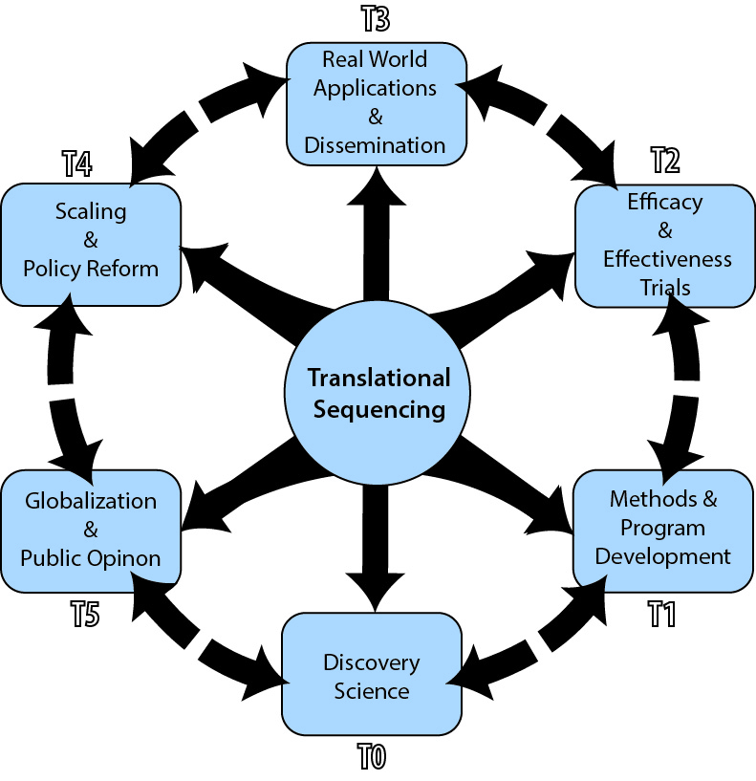
Mission
To prevent social ills and promote wellbeing by translating scientific knowledge into effective and sustainable practices, systems and policies.

Slide 4
Goals Achieving socially significant outcomes
Translational Science: To encourage interdisciplinary teams of scientists to apply integrative models to understand (a) conditions that lead to poor mental, behavioral and physical health and (b) factors the underlie intervention effects.
Implementation and Systems Change: To advance science-driven practices to reducing risks and disadvantages and encourage system-wide capacity to effectively implement evidence-based strategies.
Advocacy/Policy: To promote governmental adoption of a “prevention model” to reduce expenditures and benefit society.

Slide 5
Sign in sheet
Folders with handouts
Speakers have 15 minutes with 5 minutes of Q&A afterwards
Please complete [anonymous] evaluation form after each presentation

Slide 6
Violence Against Women
“Any act of gender-based violence that results in, or is likely to result in, physical, sexual or mental harm or suffering to women, including threats of such acts, coercion or arbitrary deprivation of liberty, whether occurring in public or in private life.” (United Nations)
Unseen wounds
Violence is relational, intergenerational, and affects the family system

Slide 7
Prevalence and Types of Violence
Globally, at least 35% of women experience violence in their lifetime
1 in 3 women has experienced IPV in the U.S.; one-third of those experienced multiple types of violence
Nearly half have experienced psychological aggression
Nearly 1 in 5 women (18.3%) in the U.S. have been raped in their lifetime; more than half by an intimate partner and over 40% before age 18
1 in 6 women (16.2%) in the U.S. have experienced stalking; two-thirds by current/former intimate partner and about 20% before age 18
CDC, National Intimate Partner and Sexual Violence Survey, 2010 Report

Slide 8
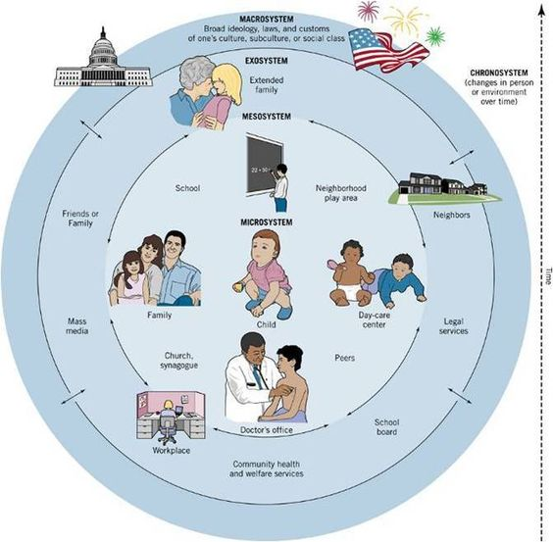
Ecological Understanding of Risk and Protective Factors

Slide 9
Violence as a structural and systemic problem
Violence against women - particularly IPV and sexual violence - are major public health problems and violations of women's human rights.
Unequal position of women relative to men and normative use of violence to resolve conflict are strongly associated with both IPV and sexual violence.
Related to cultural context

Slide 10
Individual Risk Factors
Lower levels of education
History of maltreatment as a child
History of witnessing family violence
Harmful use of alcohol
Attitudes that are accepting of violence and gender inequality

Slide 11
Health, Mental Health, and Economic Consequences
Many physical health problems: frequent headaches, chronic pain, poor sleep, activity limitations, asthma, diabetes, STI’s, reproductive problems
”The Body Keeps the Score” (Van der Kolk)
Mental health problems: depression, anxiety, PTSD, suicidality, alcohol/substance use
Reduces productivity and drains public budgets through direct and indirect economic costs – lost wages, healthcare and services, police, legal, etc.
Economic toll of IPV alone in the U.S. is at least $5.8 billion annually

