Slide 1


Overcoming Child Poverty in America
Bruce Lesley
President, First Focus
March 1, 2017

Slide 2
Money Matters: Federal Failure to Invest in Our Future

Slide 3

Congress Invests Less Than 8% in Kids

Slide 4
Cutting Investments in Kids Disproportionately
Children’s share of overall spending has dropped by 7.3% in six years
8.45%
7.83%

Slide 5
Children: Small Fraction of All New Spending
2.1%

Slide 6
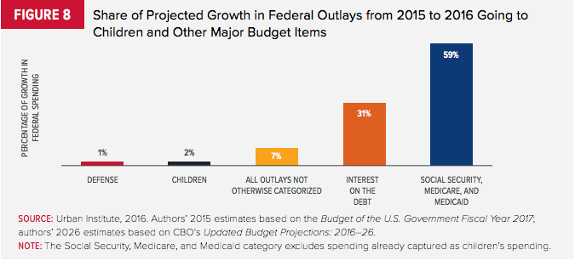
Children: Just 2% of All New Spending
Source: Kids’ Share 2016, Urban Institute

Slide 7
Child Poverty in America

Slide 8
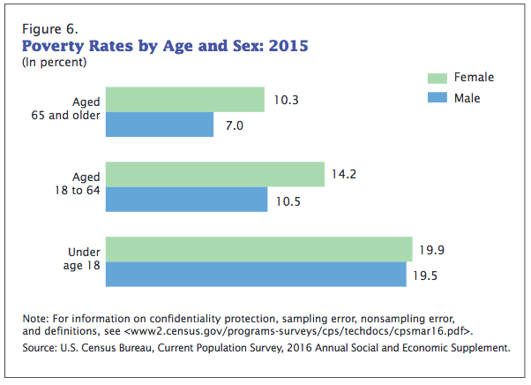
Child Poverty in the United States
Children are 69% more likely to live in poverty than adults

Slide 9
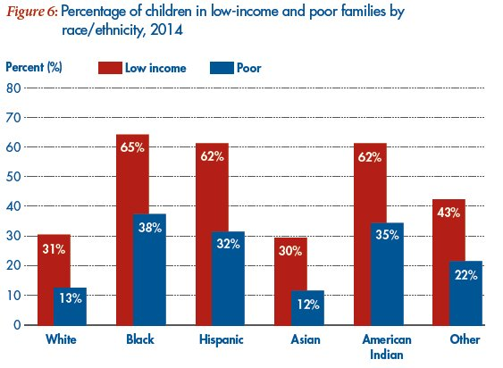
Child Poverty in America - 2014

Slide 10
Poverty Rates by Age (1968-2011)
25.0
21.9
15.6
8.7
Source: U.S. Census Bureau
Children
Seniors

Slide 11
Smeeding & Waldfogel, 2010

Slide 12

What Did Britain Do?: Lessons for the United States
The British anti-poverty strategy had three parts:
Promoting work and making work pay
National minimum wage
Working Families Tax Credit
Reduced payroll taxes for low-income workers
2) Raising incomes for families with children
Child Benefit
New Child Tax Credit for low-income families
New Child Trust Funds
3) Investing in children

Slide 13
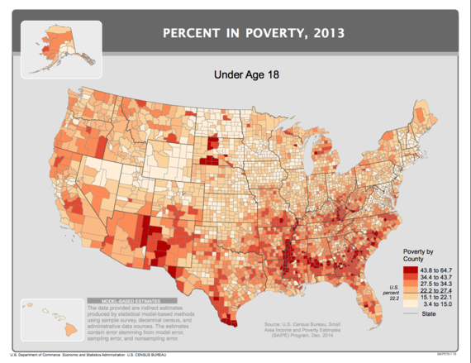
Child Poverty in the United States

Slide 14
AECF’s KIDS COUNT Worst States in
Child Well-Being: Bottom One-Third in RED
WA
MT
ND
ME
OR
MN
VT
ID
SD
NY
NH
WI
MA
WY
MI
CT
RI
IA
PA
NJ
NE
NV
IN
OH
MD
DE
UT
IL
CA
CO
KS
WV
VA
DC
MO
KY
TN
NC
AZ
OK
NM
AR
SC
MS
AL
GA
TX
LA
AK
FL
HI

Slide 15
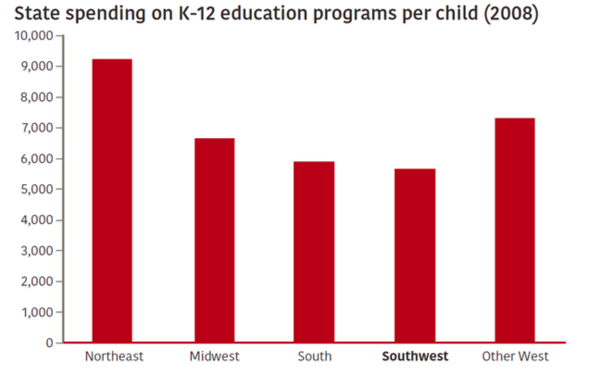
Money Matters:
Southwest & South Fail to Invest in Kids
Rockefeller Institute

Slide 16
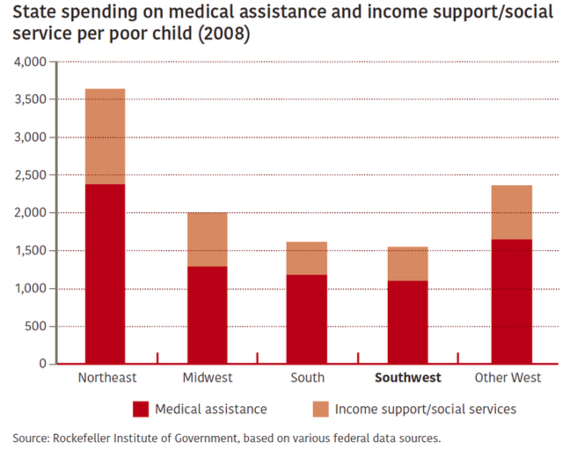
Money Matters:
Southwest & South Fail to Invest in Kids

Slide 17
KIDS COUNT Bottom Third Education “Effort Index”
4 – A
3 – B
1 – C
2 – D
7 – F
WA
MT
ND
ME
OR
MN
VT
ID
SD
NY
NH
WI
MA
WY
MI
CT
RI
IA
PA
NJ
NE
NV
IN
OH
MD
DE
UT
IL
CA
CO
KS
WV
VA
DC
MO
KY
TN
NC
AZ
OK
NM
AR
SC
MS
AL
GA
TX
LA
AK
FL
HI

Slide 18

Need to Invest in the Next Generation
“The demographic reality is that America's youth – and more specifically its racial minority youth – is its future.”
– William Frey, CNN, “Diversity is an Opportunity, Not a Threat, for America” (Mar. 29, 2016)

Slide 19
Creating a State, Local and National Agenda

Slide 20

Overcoming Barriers
Societal Barriers
Racial Generation Gap
Parent Bubble: “not the role of gov’t”
Public Education Barriers
Unaware of Important of Policy to Kids
Kids Are Viewed as “Soft” News
Child Advocacy Barriers
Kids Don’t Vote, Don’t Give Campaign Contributions
Silos -> Advocates Need to
  Bridge Silos/Come Together

Slide 21
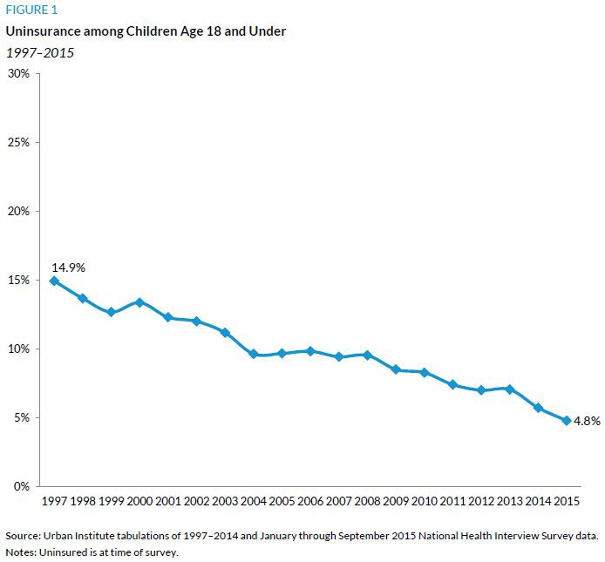
Play Defense: Medicaid and CHIP Work
President-elect Trump & Speaker Ryan’s agenda:
Repeal Obamacare
Block grant Medcaid
Rollback CHIP coverage?
MESSAGE:
DO NO HARM

Slide 22
Budgets Matter: Kids Should Not Lose Ground

Slide 23
Not only are voters pessimistic, but they don’t see a reason for hope around the corner as a majority are strongly not confident that the next generation will be better off. Typically, higher socio-economic voters are more optimistic, but even wealthier are voters are downbeat.
And do you feel confident or not confident that life for our children’s generation will be better than it has been for us?

Slide 24
Support for a Children’s Policy Agenda
Issue Result Intensity
Cut Child Poverty In Half: 82-13% 68%
Extend Child Tax Credits: 81-12% 69%
Adopt a Children’s Budget: 66-22% 51%
Adopt Bipartisan Children’s 78-15% 62%
Commission:

Slide 25

A Pathway Forward
Adopt a Children’s Policy Agenda
Bipartisan Approach: “Begin with Children”
Reach Out Across Generations: Break the Racial Generation Gap
Embrace Diversity and Changing Demographics
Reach Out to Strongest Allies: Minority Groups (Hispanic, Black, and Asian-Americans), Women, and Millennials
Need a New Generation of Champions for Children

Slide 26

Affirming a Children’s Policy Agenda
Adopt a Children’s Opportunity Policy Agenda
Oppose Federal Rollbacks and Cuts to Children
Adopt a Child Poverty Target
Establish a Children’s Commission/Office/Ombudsman
Reduce Child and Family Homelessness
Address Child Hunger/Summer Programs
Engage Institutions (Hospitals, Universities, Schools)
Expand Outreach and Enrollment in Federal Programs
Expand Early Childhood Programs
Expand Youth Employment Opportunities
Expand After-School/Child Care Programs
Support Community Schools
Raise Minimum Wage
Provide Legal Protections for
  ALL Children

Slide 27
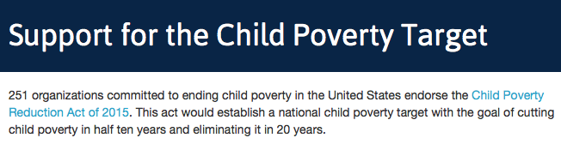
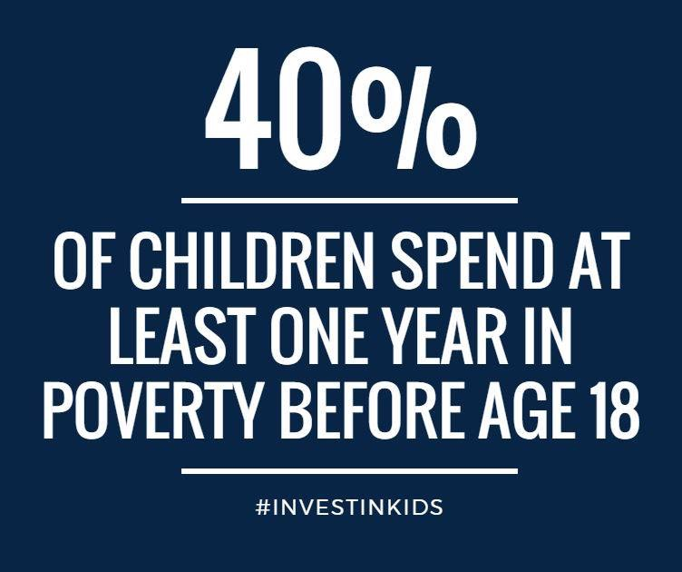
“Child Poverty Reduction Act of 2015” –
H.R. 2408 (Reps. Davis, Lee, Connolly, Cummings, & 9 others)
S. 2224 (Sens. Casey, Baldwin, Brown)

Slide 28
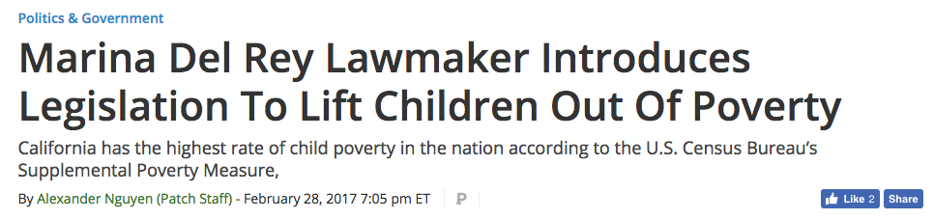
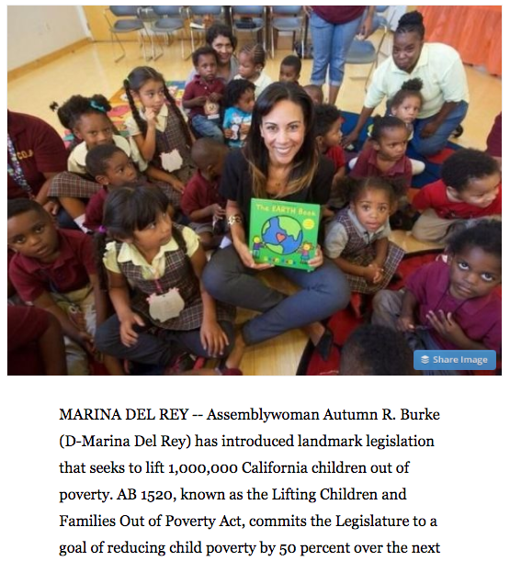

Slide 29
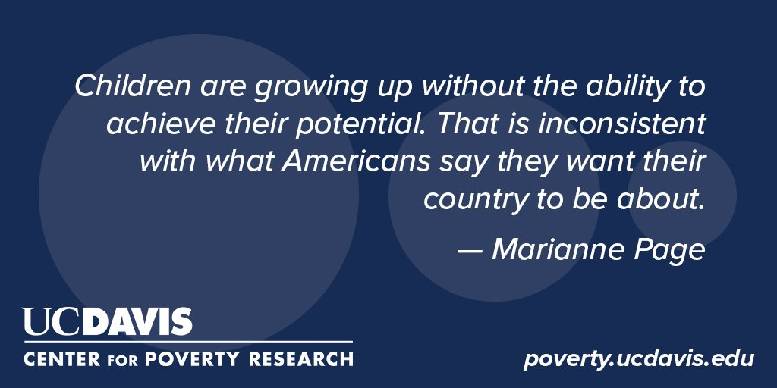

Slide 30

Thank You!
Bruce Lesley
E-mail: BruceL@firstfocus.org
Twitter: @BruceLesley
Phone: 202-657-0670
www.firstfocus.org

