Slide 1
The Root Causes of Poverty and Its Effects on Children and Youth
J. Lawrence Aber
Willner Family Professor of Psychology and Public Policy
New York University

Slide 2
1. Nature and Causes of Poverty
Dimensions of Poverty
Levels of Income Poverty
Dynamics of Poverty

Slide 3
Dimensions of Poverty
Absolute Income Poverty
Relative Income Poverty
Subjective Income Poverty
Material Deprivation
Assets – Debts = Wealth

Slide 4
Figure 1. Official Poverty Rates for Children in Single-Mother Households, All Children, and the Elderly, 1959-2014

Slide 5
Alternative Measures of Poverty
National Academy of Science Report on “Measuring Poverty”.
+ Add benefits and transfers.
- Subtract work expenses and taxes.
? Adjust for historical changes and regional differences in “Cost of Living”.
Family Self-Sufficiency Standard?
(Citro & Michael, 1995)

Slide 6
Figure 2. Poverty Rates under the Official Poverty Measure, the Columbia Poverty Measure, and the Consumption-Based Poverty Measure, 1967-2012

Slide 7
“Causes” of Poverty in the U.S.
Economic
Macro-economic performance: per capita GDP.
Labor supply incentives implicit in the tax/transfer system.
Structural labor market changes favoring high-skill workers.
(Haveman & Smeeding, 2007)

Slide 8
“Causes of Poverty in the U.S. (Cont’d.)
Social
Racial discrimination in the labor and housing markets.
Failure of schools to offset the race/income “achievement gaps”.
Intergenerational transmission processes.
(Haveman & Smeeding, 2007)

Slide 9
“Causes” of Poverty in the U.S. (Cont’d.)
Policy
Policies based on faulty premises.
Policies inefficiently implemented and/or created perverse incentives.
Total investments too low.
(Danziger, 2007)

Slide 10
2. Consequences and Effects of Poverty
Disparities in Well-Being!
Mediating Processes?

Slide 11
Disparities in Child Well-Being: Health
Neonatal and post-neonatal mortality.
Injuries due to accidents or physical abuse/neglect.
Asthma.
(Aber, Bennett, Li & Conley, 1997)

Slide 12
Disparities in Child Well-Being: Development
Developmental Delays and Lower IQ’s.
Lower Math/Reading Achievement.
Repeat Grade/School Dropout.
More Mental, Emotional and Behavioral Problems.
(Gershoff, Aber & Raver, 2003; Yoshikawa, Aber & Beardslee, 2012)

Slide 13
Mediating Processes?
In general, the research field is moving away from the question of whether poverty has a causal effect on health and development to the questions of HOW? UNDER WHAT CONDITIONS? and WHAT CAN BE DONE ABOUT IT?

Slide 14
Mediating Processes? (Cont’d.)
Biological/Neurological/Physiological
Family/Parenting
Social/Relational/Network
Institutional/Organizational/ Community

Slide 15
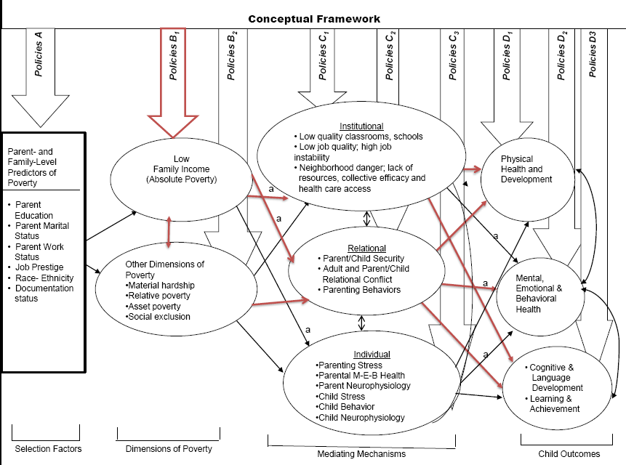

Slide 16
Summary
Poverty is multidimensional in nature, complexly determined, profoundly unevenly distributed and more widespread than people think.
The levels of poverty, no matter how defined, are very high in the U.S. (and higher than in comparable countries).
Poverty is not only associated with, but causes disparities in health, education, development and future life changes.

Slide 17
Summary (continued)
A more complete and precise scientific understanding of the causal processes that mediate the effect of poverty on child and human development is needed to better inform the design of programs and policies.

Slide 18
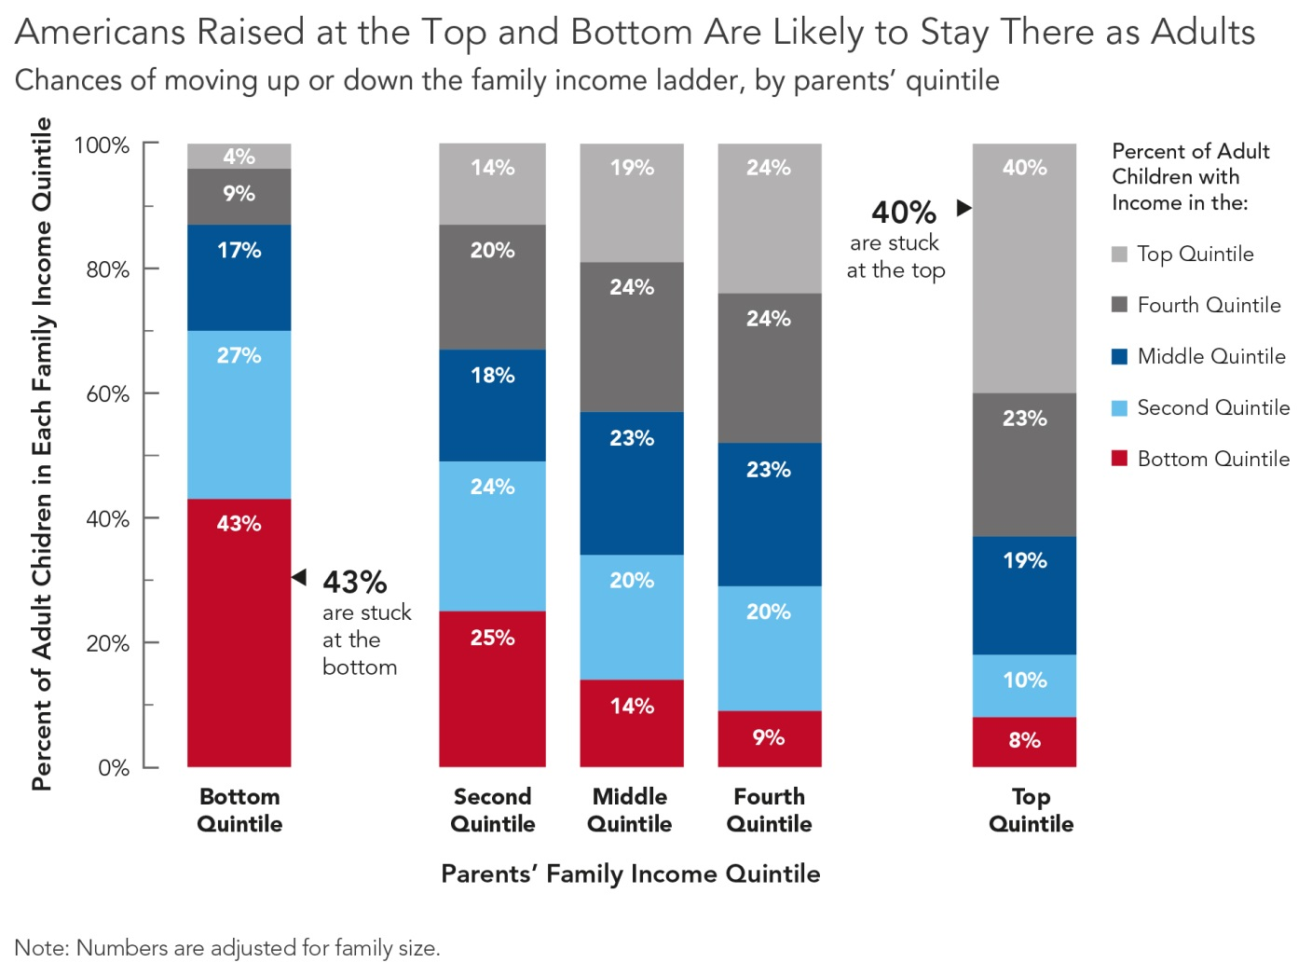
Figure 3. Income Quintile of Children When They Grow Up Relative to Their Parents’ Income Quintile

Slide 19
Figure 9. Median Family Income of Adults Age 30-39 by Education Level, 1964-2014

Slide 20
References
Aber, J.L., Bennett, N.G., Li, J., & Conley, D.C. (1997). The effects of poverty on child health and development. Annual Review of Public Health, 18. 463-483.
Aber, L., Morris, P., & Raver, C. (2012). Children, Families and Poverty: Definitions, Trends, Emerging Science and Implications for Policy. Social Policy Report volume 26, number 23: Publication of the Society for Research in Child Development.
Citro, C.F., & Michael, R.T. (Eds.) (1995). Measuring Poverty: An New Approach. Washington, DC: The National Academies Press.
Danziger, S.H. (2007). Fighting poverty revisited: What did researchers know 40 years ago? What do we know today? Focus: Institute for Research on Poverty, 25(1): 3-11.
Gershoff, E.T., Aber, J.L., Raver, C.C., & Lennon, M.C. (2007). Income is not enough: Incorporating material hardship into models of income associations with parenting and child development. Child Development, 78(1), 96-115

Slide 21
References (cont’d.)
Gershoff, E.T., Aber, J.L, & Raver, C.C. (2003). Child poverty in the U.S.: An evidence-based conceptual framework for programs and policies. In R.M. Lerner, F. Jacobs, & D. Wertlieb (Eds.), Handbook of Applied Developmental Science, Vol. 2 (pp.81-136). Thousand Oaks, CA: Sage Publications.
Haveman, R., & Smeeding, T. (2007). Poverty Policy and Poverty Research Over Four Decades. Focus, Special 40th Anniversary Issue. Vol. 25:1, Spring-Summer.
Yoshikawa, H., Aber, J.L., & Beardslee, W.R. (2012). The Effects of Poverty on Children’s Mental, Emotional and Behavioral Health: Implications for Prevention. American Psychologist, 67(4), 272-284.

